Slide 1
Four Day Experience < Thursday to Sunday - October 17 -20, 2024
New and Diverse < Projection Mapping, Mural Painting, Media Light and Interactive Art
30+ City Blocks < Spanning The Urban Core + Crossing Bridges
Free < and Open To The Public
Lasting Impact < Created by Diverse Artists For The Future Region

Slide 2
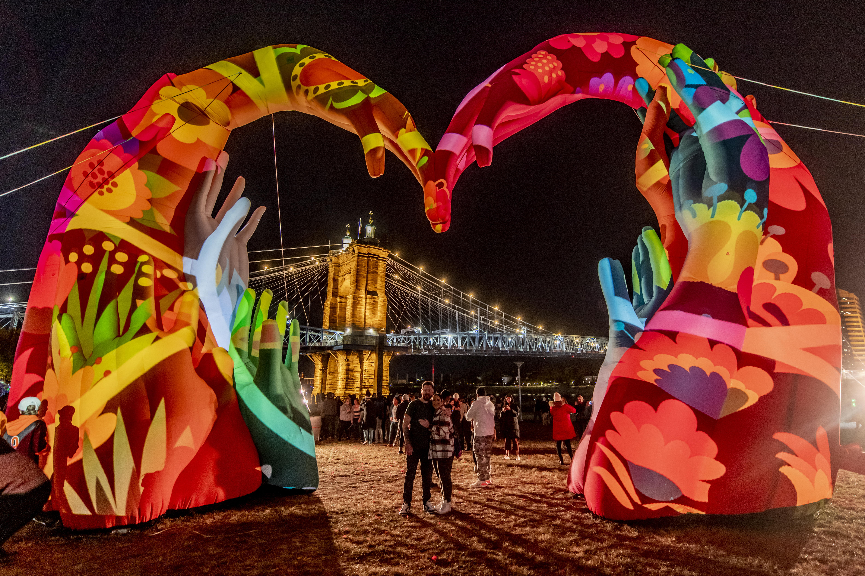
LASTING IMPACT
international public art curation

Slide 3
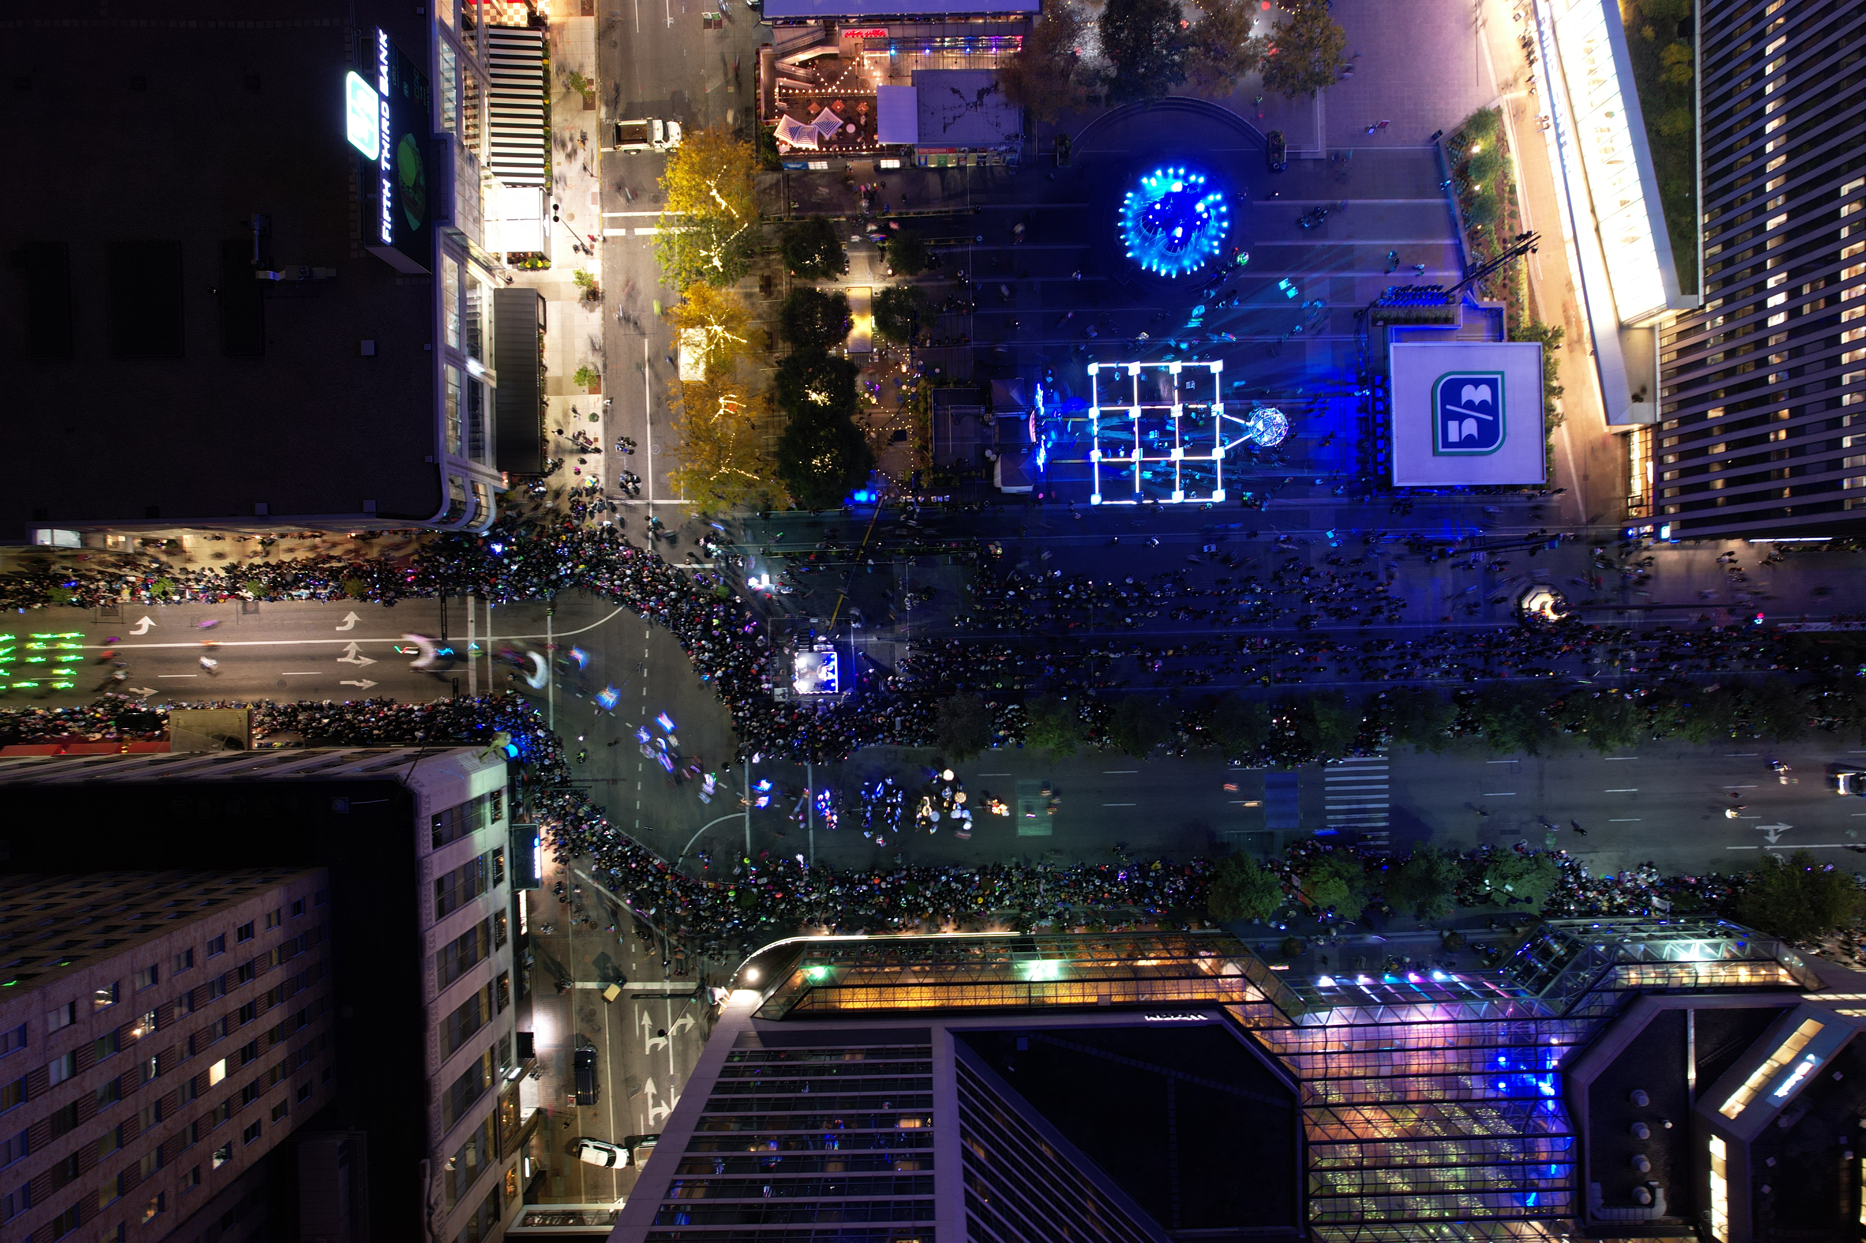
BUILDING THE FUTURE CITY
placemaking & cultural landmarks

Slide 4
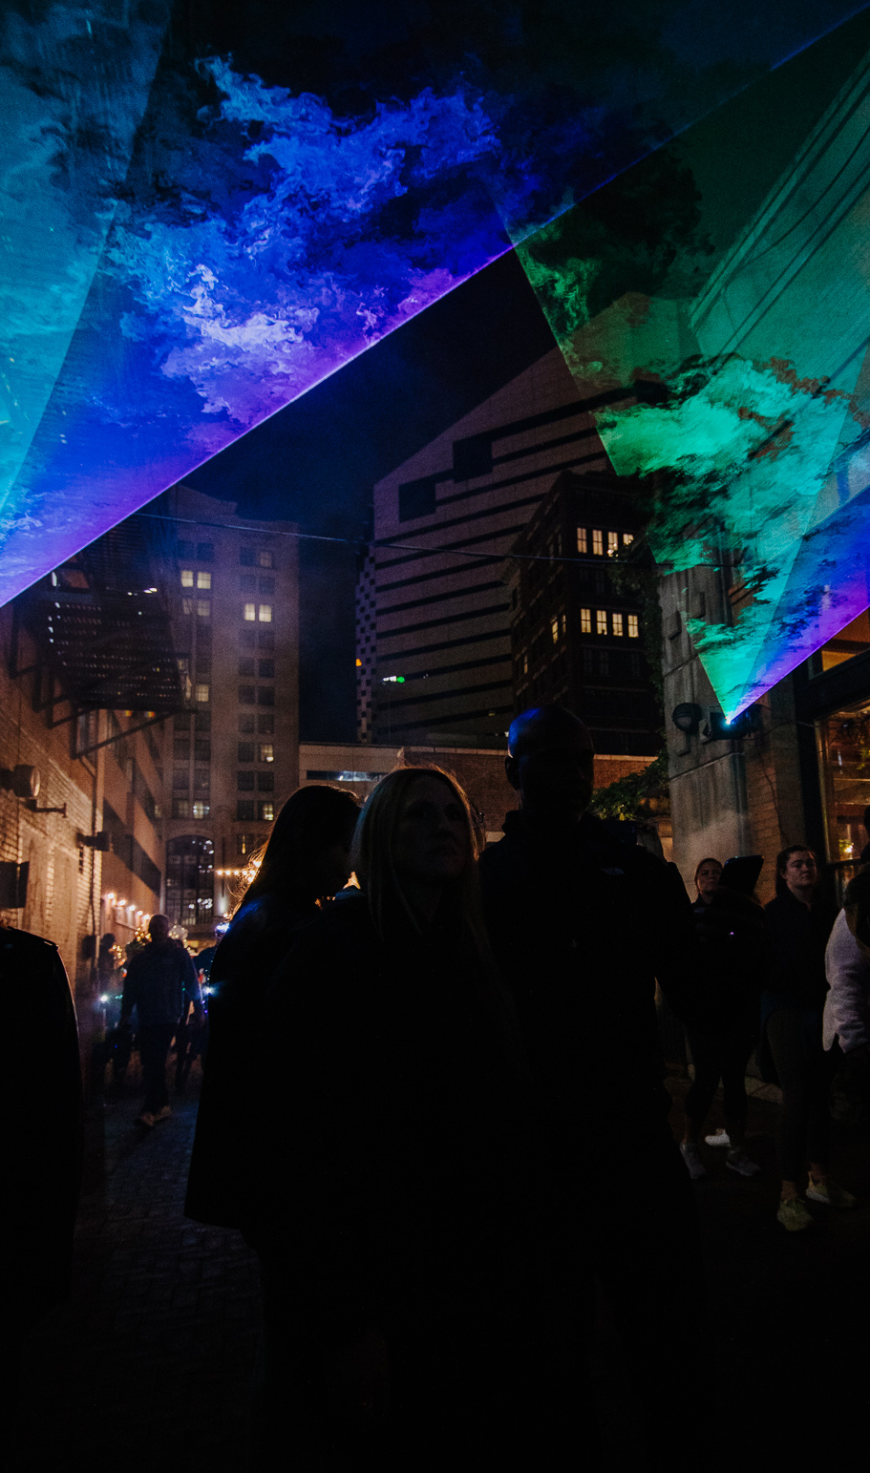
2022 overview
The four-night, 30-city block, outdoor art experience inspired innovation and creativity through street art, projection mapping, and light-based installations.
FOUR DAY ART EVENT • Thursday, October 13 - Sunday, October 16, 2022 NEW AND DIVERSE • Projection Mapping, Mural Painting, Media Light and Interactive Art
30+ CITY BLOCKS, 2 states • Spanning the Urban Core and Crossing Bridges
FREE • And Open to the Public
LASTING IMPACT • Created by Diverse Artists for the Future Region
2022 theme • Togetherness
2.2+M
100+
$126+M
ATTENDANCE
ART INSTALLATIONS
ECONOMIC IMPACT

Slide 5
THE EVOLUTION OF BLINK
2017
2019
2022
Casting a Vision for a future city
A REGION UNITED
Making our place in the Global landscape
Expanded footprint into Northern Kentucky
1.3 Million Attendance
13 Permanent Murals
First year
1.1 Million Attendance
10 Permanent Murals
International Artists and Media Coverage
2.2 Million Attendance
17 Permanent Murals
Notes:
Economic impact report coming out next Friday - show more stats - ANDREW TO OWN THIS

Slide 6
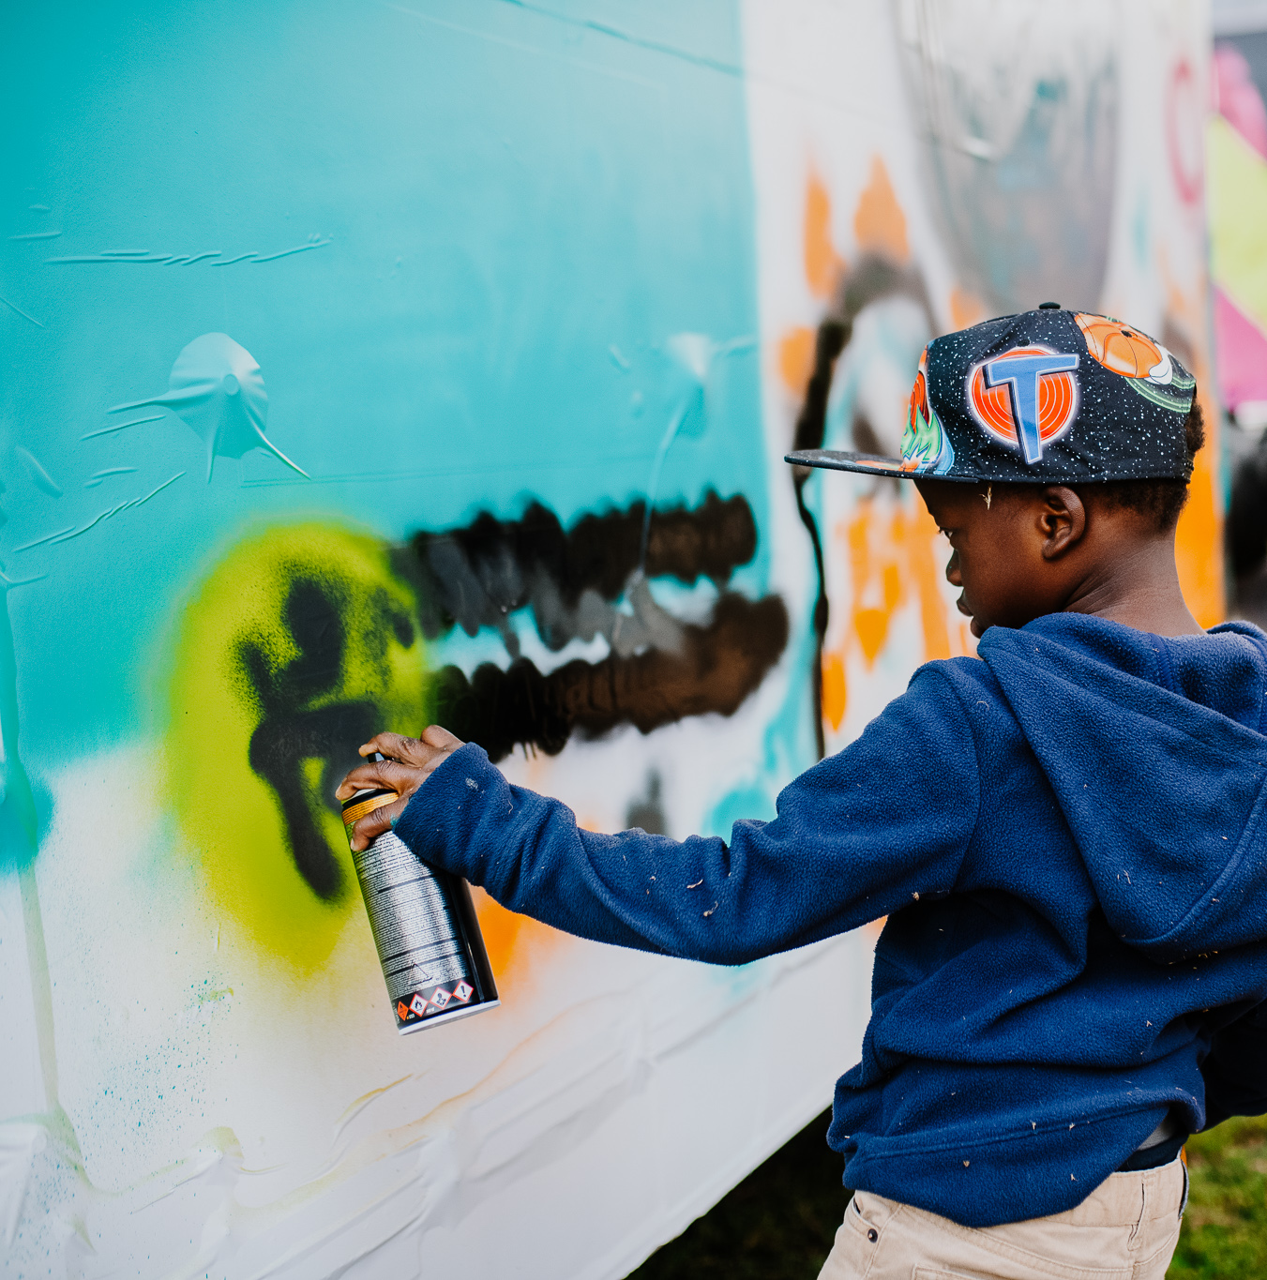
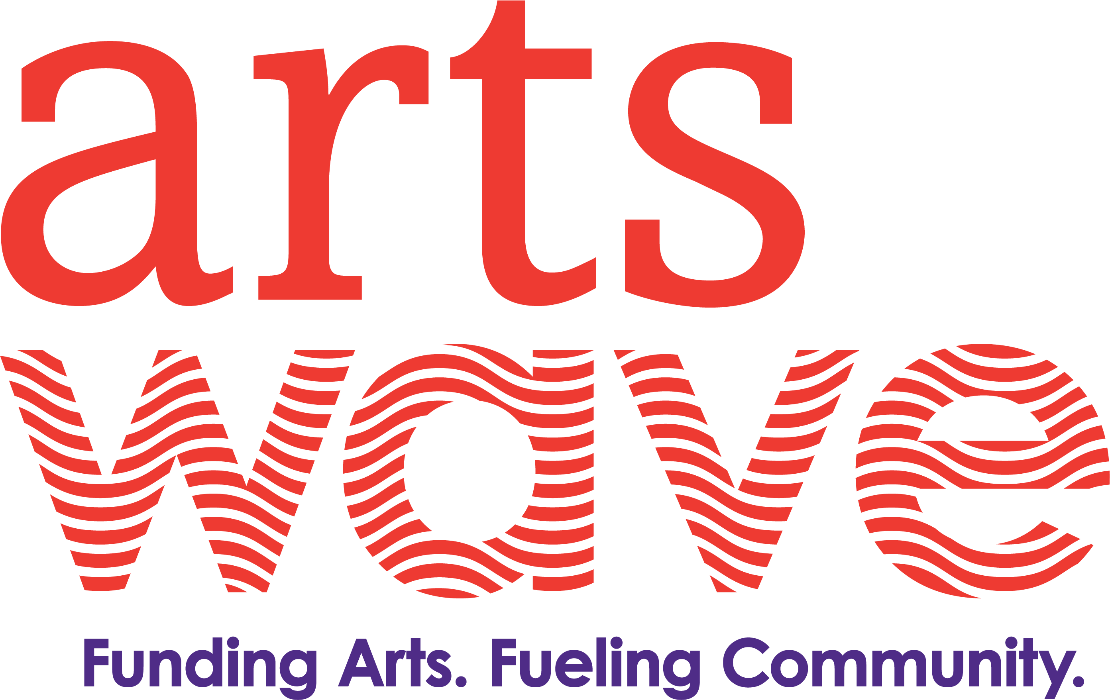
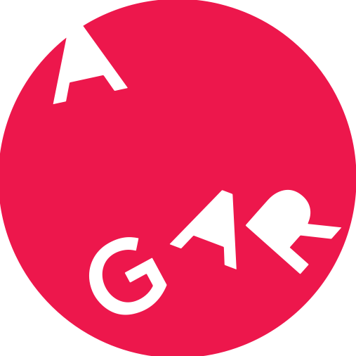
COMMUNITY INVOLVEMENT
Because of the exponential growth of this event, AGAR has curated a team of community partners that includes local nonprofits, universities, artists, and collectives to help facilitate the production of the festival and micro events throughout the city. Some ways the community got involved include:
Partnership with 3CDC and City of Cincinnati public spaces
Collaboration with Chroma Projects for Hanna’s Playground
Cincy Nice Social House and artist engagement
Ish Festival’s curation and management of the 2022 BLINK Parade
Artworks involvement
Miami University, Northern Kentucky University, University of Cincinnati and Xavier University student Involvement

Slide 7
Direct spending
Revenue sources
3 categories of funding
$6.35M
$1.9M
$1.95M
$2.3M
Budget
Corporate sponsorship
Philanthropic support
Government funding
$1,500,000
Artist fees and honorariums
$1,850,000
Attendees
From all over
Equipment rentals
$300,000+
2M+
52%
9.8%
Local union labor
Attendees across the 4-day experience
Hamilton County
Outside the Cincinnati/nky region
TWITTER FOLLOWERS
FACEBOOK LIKES
33,288
INSTAGRAM FOLLOWERS

Slide 8
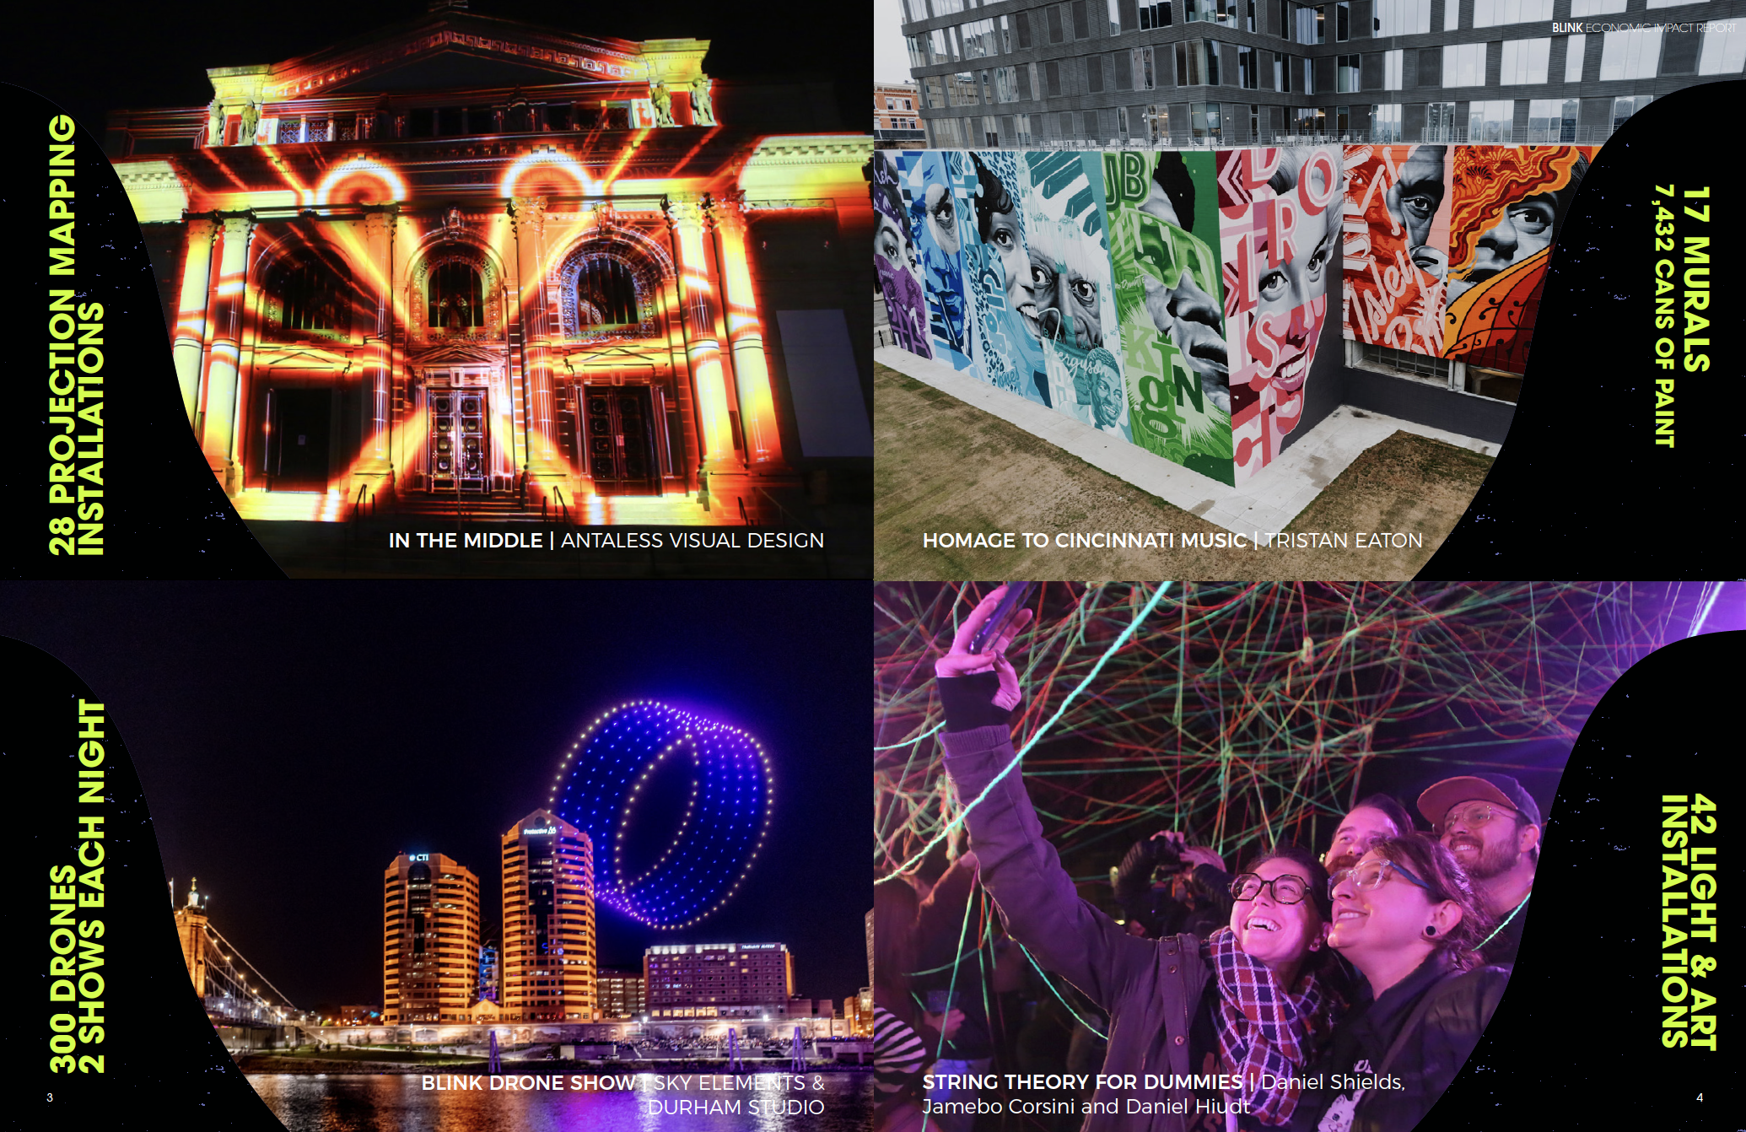

Slide 9
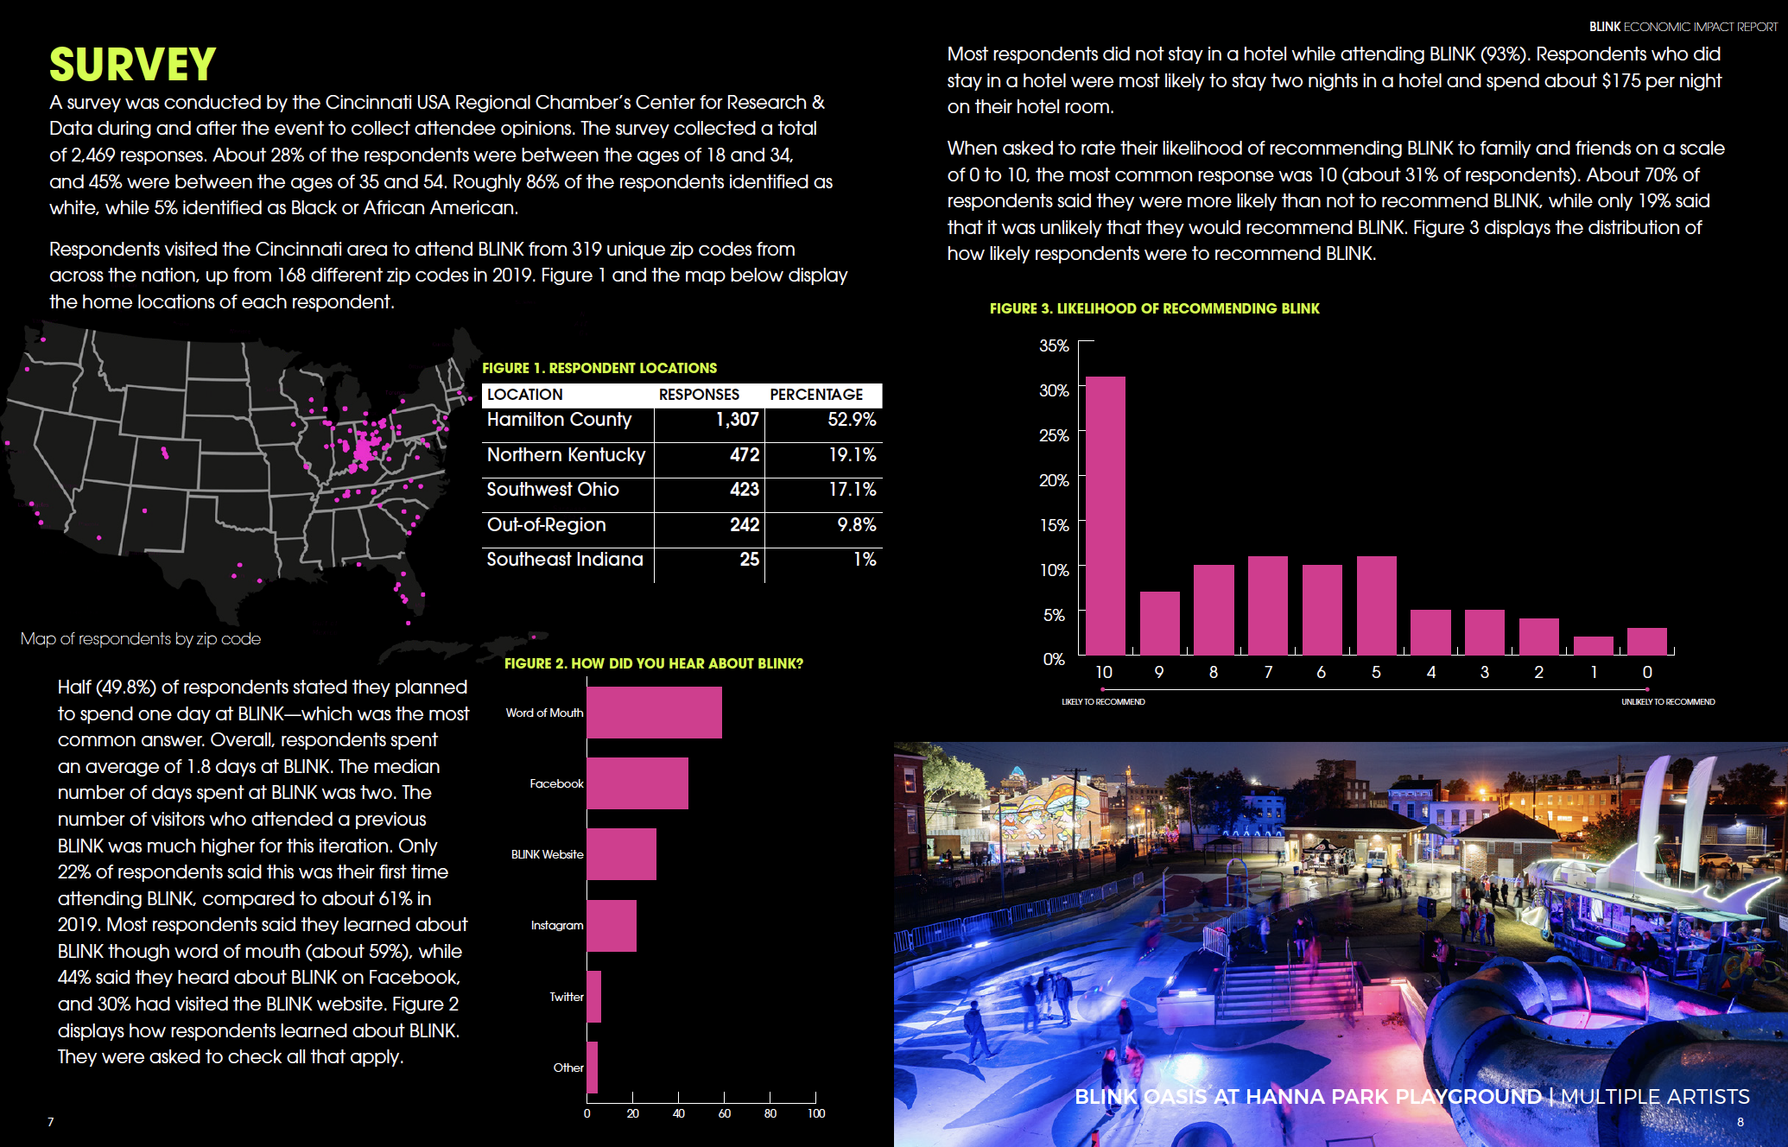

Slide 12
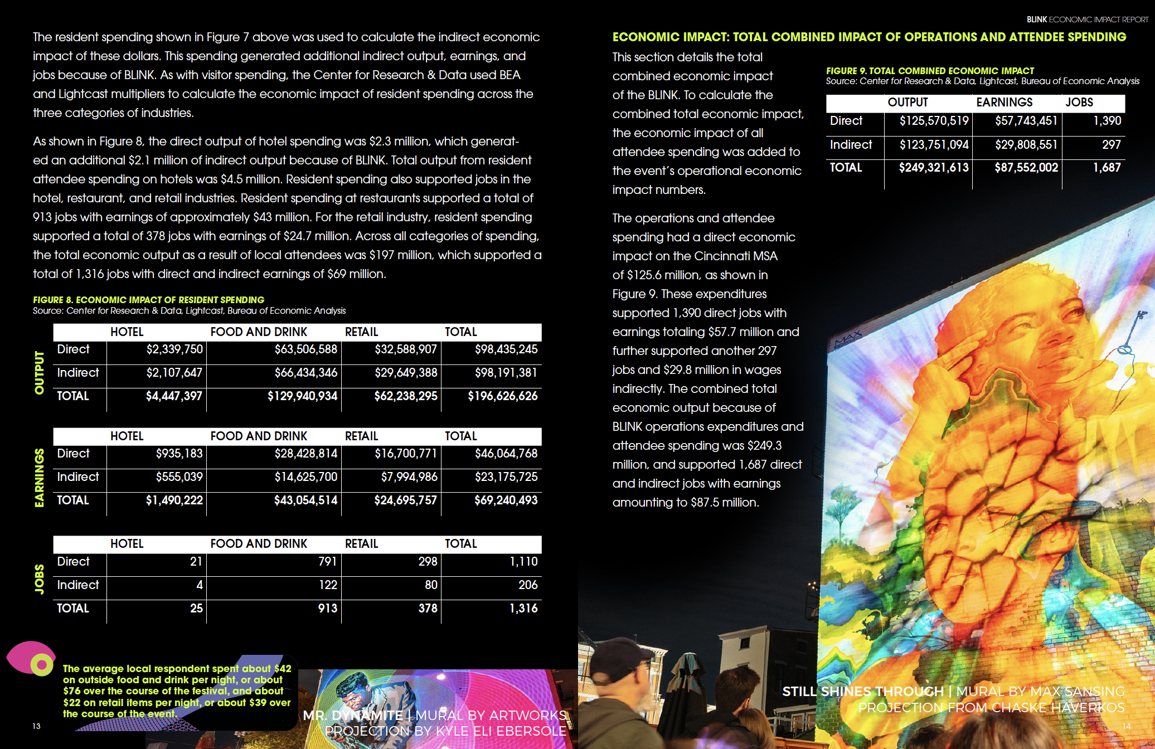

Slide 14
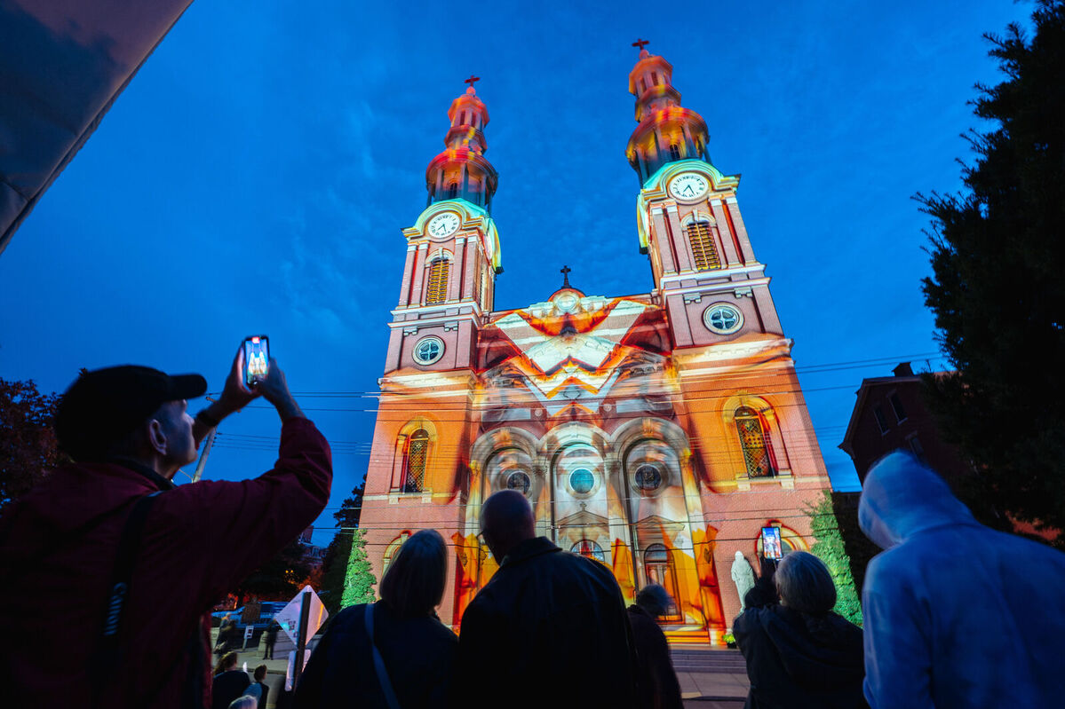
2024 Opportunities
As BLINK™ returns in 2024 after its most successful year yet we are looking for partnerships that align organizations with cultural-diverse audiences inside of a large-scale immersive experience. FEATURED INSTALLATION
$100,000 - $150,000 investment to have a Featured Installation presented by “Your Organization” and receive premium on-site, digital, and social media recognition across BLINK’s physical and digital footprint. Featured Installation Sponsors also have the opportunity to bring an installation to a site/location that is significant to the organization, build employee engagement initiatives around the installation including site prep, volunteer opportunities, watch-parties, etc. Past featured installation sites include The American Building (pictured on the right) presented by Kroger®
SITE +
LOCATION SPECIFIC
EMPLOYEE ENGAGEMENT
PREMIUM recognition across physical and digital footprint

Slide 15
Get in touch: Justin Brookhart
Executive Director - BLINK
justin@blinkcincinnati.com
903.238.3270

