Slide 1

Foreign Exchange: Fundamental & Technical Factors, and the New Efficiencies Provided by Fintech
Annual Conference March 10, 2020

Slide 2
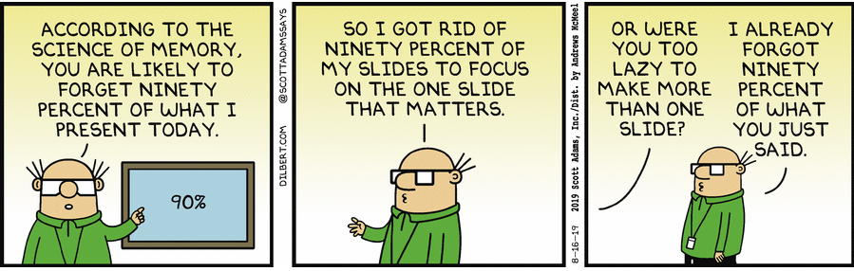
1

Slide 3
Foreign Exchange – Fundamental Analysis

Slide 4
Fundamental Analysis
Business, Economic and Political Factors
Monetary and Fiscal Policy
Equity Markets
Commodity Markets
Legislative Changes
Geopolitical Events
3

Slide 5
Fundamental Analysis
Currency Summary – EUR (Euro)
The Eurozone economy is slowing, inflation is below target, and the possible, eventual impact of Brexit remains a risk.
A hawkish ECB last fall has now turned dovish since spring, taking depo rates more deeply negative.
There are mixed economic indicators:
  EU jobless rate at 6.2 percent, a record low.
  Germany’s ZEW Indicator of Economic Sentiment has fallen to -22.8, its lowest level in over a decade.
  Italy and much of Southern Europe are in recession.
The Euro is likely to remain weak until a definitive end to quantitative easing is seen.
4

Slide 6
Fundamental Analysis
Currency Summary – GBP (British Pound)
The Pound remains near its initial post Brexit referendum lows, with a recent rally due to the potential transition deal negotiated between the EU and the UK Government, making a “hard” separation less likely.
PM Johnson now needs to get approval of the plan by Parliament, but due to ongoing opposition is attempting to call for a general election on December 12. But for this he needs approval of 2/3 in the House of Commons. The EU has granted an extension until January 31, 2020.
Like in the EU and USA, employment remains strong, and tame inflation may allow for a Bank of England rate cut, should Sterling steady and calm investors.
Hard-boiled Brexit or soft, what will the longer term impact be on the UK economy?
5

Slide 7
Fundamental Analysis
Currency Summary – CAD (Canadian Dollar)
The USMCA trade deal has led to a stronger, steadier Canadian Dollar in 2019.
Recent optimism on a resolution to the USA - China trade war is also supportive.
The rebound in oil prices from the low $40s to the mid $50s per barrel, and structural changes in the oil industry, have reduced energy price induced volatility in the currency.
The Bank of Canada has kept monetary policy and interest rates steady in the face of economic uncertainty, although another U.S. Federal Reserve cut might force its hand to match.
Would an economic downturn be even more impactful to Canada than to the USA?
6

Slide 8
Fundamental Analysis
Currency Summary – JPY (Japanese Yen)
Japanese economic growth remains stagnant, with no change to monetary policy likely in the near future. Official interest rates remain negative.
Despite a less than stellar economic outlook, the Yen remains a “safe haven” money, generally benefitting in times of market volatility or economic concerns.
The JPY has held firm in the face of the USA - China trade disagreement, in spite of the fact that Japan’s economy relies heavily on trade with both countries.
Could recession concerns and a major selloff in stocks lead to a much stronger Yen, or would the negative economic impact on Japan ultimately have the opposite effect?
7

Slide 9
Fundamental Analysis
Currency Summary – MXN (Mexican Peso)
While the MXN has rebounded from its 2016 lows, and fears of the impact of the proposed border wall and more drastic immigration restrictions have begun to ease, the Peso remains at weak levels historically.
In spite of Mexico’s close economic ties to the USA, the MXN remains vulnerable to any news adversely impacting emerging markets.
As with Canada, higher oil prices have been somewhat supportive, as is the framework of the new USMCA trade deal.
Any economic downturn in the USA is likely to have an exaggerated impact on Mexican output and GDP.
8

Slide 10
Fundamental Analysis
Currency Summary – CNY (Chinese Yuan)
  The trade conflict between the USA and China has dominated price action in the USDCNY exchange rate since the beginning of 2018.
  Since then, the CNY has weakened by 15% to compensate for slowing Chinese exports.
  Movement in the Yuan tends to drive all emerging markets currencies in the same direction.
  Bi-lateral tariffs now imposed by the USA and China are perceived to threaten economic growth worldwide.
  There are rumors of a first stage trade agreement between China and the USA. Will it be officially announced, signed, and approved by the U.S. Congress?
9

Slide 11
Foreign Exchange – Technical Analysis

Slide 12
Technical Analysis
Source: Reuters
11

Slide 13
Foreign Exchange – Algorithmic Trading

Slide 14

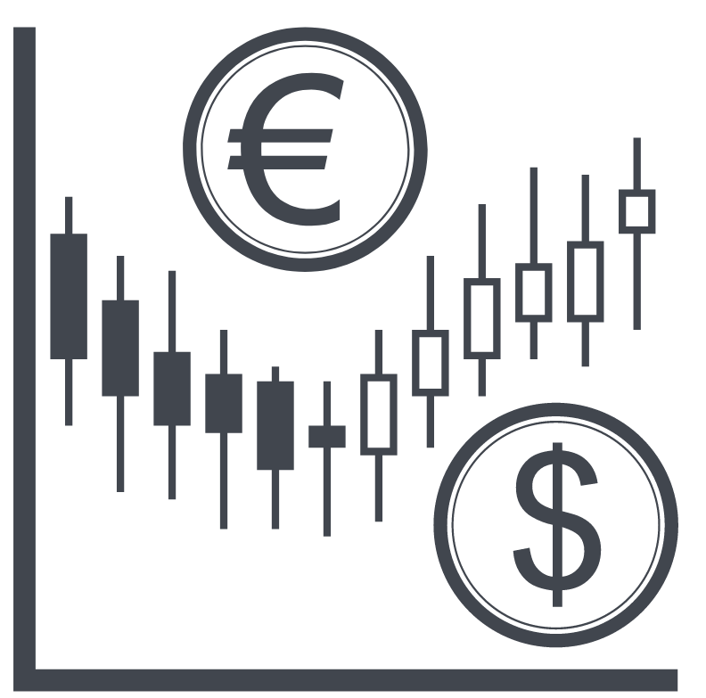



Algorithmic Trading
Overview
Algorithmic trading (program trading, black box trading, algo-trading) uses computers, programed to follow instructions (algorithms) to place trades in response to set criteria, at speed and frequencies impossible for human traders.
Today about 85% of all institutional market trading is algo driven, up from 15% in 2003.
Recent growth in algo-trading in the FX markets is intended to create efficiencies, such as reducing the time needed to execute trades, and automating the execution of orders, resulting in cost savings.
Banks have also benefitted by increasing the speed and efficiency of quoting prices to clients and counterparties over online platforms, and reducing risk exposure by matching and settling trades electronically.
13

Slide 15
Algorithmic Trading
Flash Crash
Program trading can exacerbate the impact of “flash crashes,” since many models are similarly programmed to respond to market scenarios, and do not place diverse or contrarian trades that could slow or reverse price action and volatility.
The Flash Crash of 2010 where the Dow Jones Industrial Average fell over 9% in 36 minutes, losing an estimated $1 trillion in value, was attributed to algo-trading.
More recently, in January of this year, the Japanese Yen strengthened 4% against the U.S. Dollar in a matter of minutes (see chart).
14

Slide 16
Foreign Exchange – Fintech

Slide 17


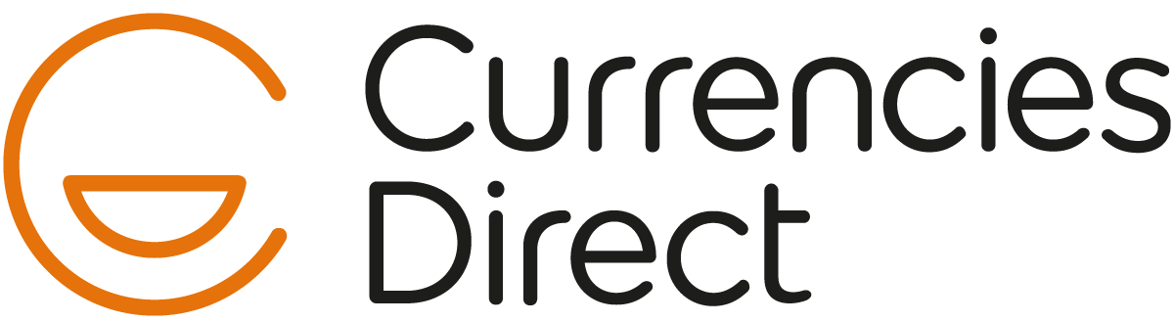
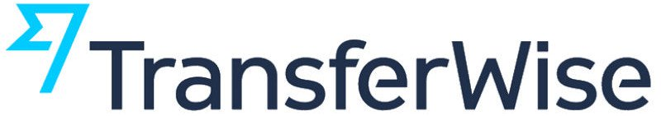
Fintech
Overview
Who Are They?
Why Now?
Firms integrating modern-day technology to offer newer, faster, and more relevant financial services.
Examples:
  Digital Lending / Credit
  Mobile Payments
Stringent regulatory standards lead to a large discrepancy between:
  Current product offerings
  Capabilities for product offerings given 21st century technology
No longer a question of ‘if’ Fintechs can provide value-add and now about finding the right ones to partner with.
81%
of banking CEOs are concerned about
the speed of technological change, more than any other industry sector¹.
1) PwC’s 19th Annual Global CEO Survey
16

Slide 18
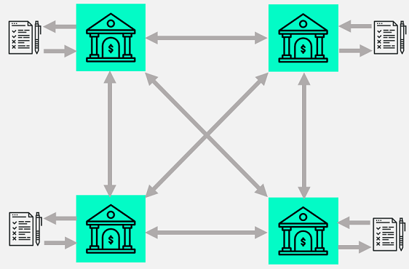
Fintech
Risk Management Enhancements
Operational
Transactional
Impacts from automation:
  Decrease in human touch points.
  Increased visibility, control and security.
Integration with a client’s ERP system.
New, as well as improvements to existing, technological tools including:
  Merchant Co-op
  Tokenization
  Device Intelligence
Allowing customers to constantly, and automatically, hedge their FX risk.
  Post-geopolitical event adjustment can be significantly reduced.
Micro-hedging
Distributed Ledger Technology:
17

Slide 19
Foreign Exchange – Product Overview

Slide 20
Product Overview
Foreign Exchange (FX) | The $5,100,000,000,000 / Day Marketplace
Foreign Exchange Market Turnover by Instrument
Net-net basis¹, daily averages in April
$Trillion
7
6
5
4
3
2
1
0
‘01
‘04
‘07
‘10
‘13
‘16
‘19
Spot
Outright forwards
FX swaps
Currency swaps
Options & other
1) Adjusted for local and cross-border, inter-dealer double-counting (i.e. “net-net” basis).
Source: BIS Triennial Central Bank Survey.
19

Slide 21
Product Overview
Structured Hedging Products
Conventional
Derivative
Spot Contracts
Outright Forwards
Window Forwards
Swaps
Non-Deliverable Forwards (NDFs)
Options and Structured Products
Cross Currency Interest Rate Swaps
20

Slide 22
Product Overview
NDF Example
ABC CO wants to start a hedging program for its monthly payroll costs in India. As a starting point, they need to buy INR 10,000,000 for next month’s payroll.
The NDF Contract:
Spot Rate = 71.60
Forward Premium = .35
Contract Rate = 71.60 +.35 = 71.95
Settlement Date = October 15, 2019
Fixing Set: Average of rate readings taken by Central Bank of India between 11:45am – 12:15pm Mumbai time, two business day prior to maturity. Central bank fixing posted on Reuters page RBIB.
21

Slide 23
Product Overview
NDF Example
Scenario 1: Hedge is in the money
Central Bank of India fixing = 65.00
Contract Value = INR 10 million/71.95 = $138,985.41
Official Fix .= INR 10 million/65.00 = $153,846.15
ABC CO Receives from KeyBank . .$ 14,860.74
Scenario 2: Hedge is out of the money
Central Bank of India fixing = 76.50
Contract Value = INR 10 million/71.95 = $.138,985.41
Official Fix .= INR 10 million/77.50 = $129,032.26
ABC CO Pays to KeyBank . $ . 9,953.15
22

Slide 24
Product Overview
Options Basics
CALL
  The right, but not the obligation, to BUY a specific amount of currency at a specified price on a pre-set date.
PUT
  The right, but not the obligation, to SELL a specific amount of currency at a specified price on a pre-set date.
European Style
  Option may be exercised at expiry only.
American Style
  Option may be exercised at any time before expiry.
23

Slide 25
Product Overview
Factors Determining Options Price
Volatility of Currency
Expiry Date
Strike Price
Spot Rate
Volatility of Currency
Expiry Date
Strike Price
Spot Rate
Interest Rate Differential
Option Price
24

Slide 26
Product Overview
Structured Hedging Products
Examples:
Range Forwards (Collars)
Participating Forwards
Forward Extras
Average Rate Options
25

Slide 27

Product Overview
Cross Currency Swaps
Inception: principal exchange is based on the prevailing spot rate and is optional.
Foreign Principal
Foreign Principal
Start
USD Principal
U.S.
COMPANY
FOREIGN SUBSIDIARY
26

Slide 28
Product Overview
Cross Currency Swaps
Maturity: principal exchange takes place at the spot exchange rate prevailing at the start of the transaction.
Foreign Principal
Foreign Principal
Start
USD Principal
USD Interest
U.S.
COMPANY
FOREIGN SUBSIDIARY
Foreign Interest
Foreign Interest
Maturity
USD Principal
Foreign Principal
Foreign Principal
27

Slide 29
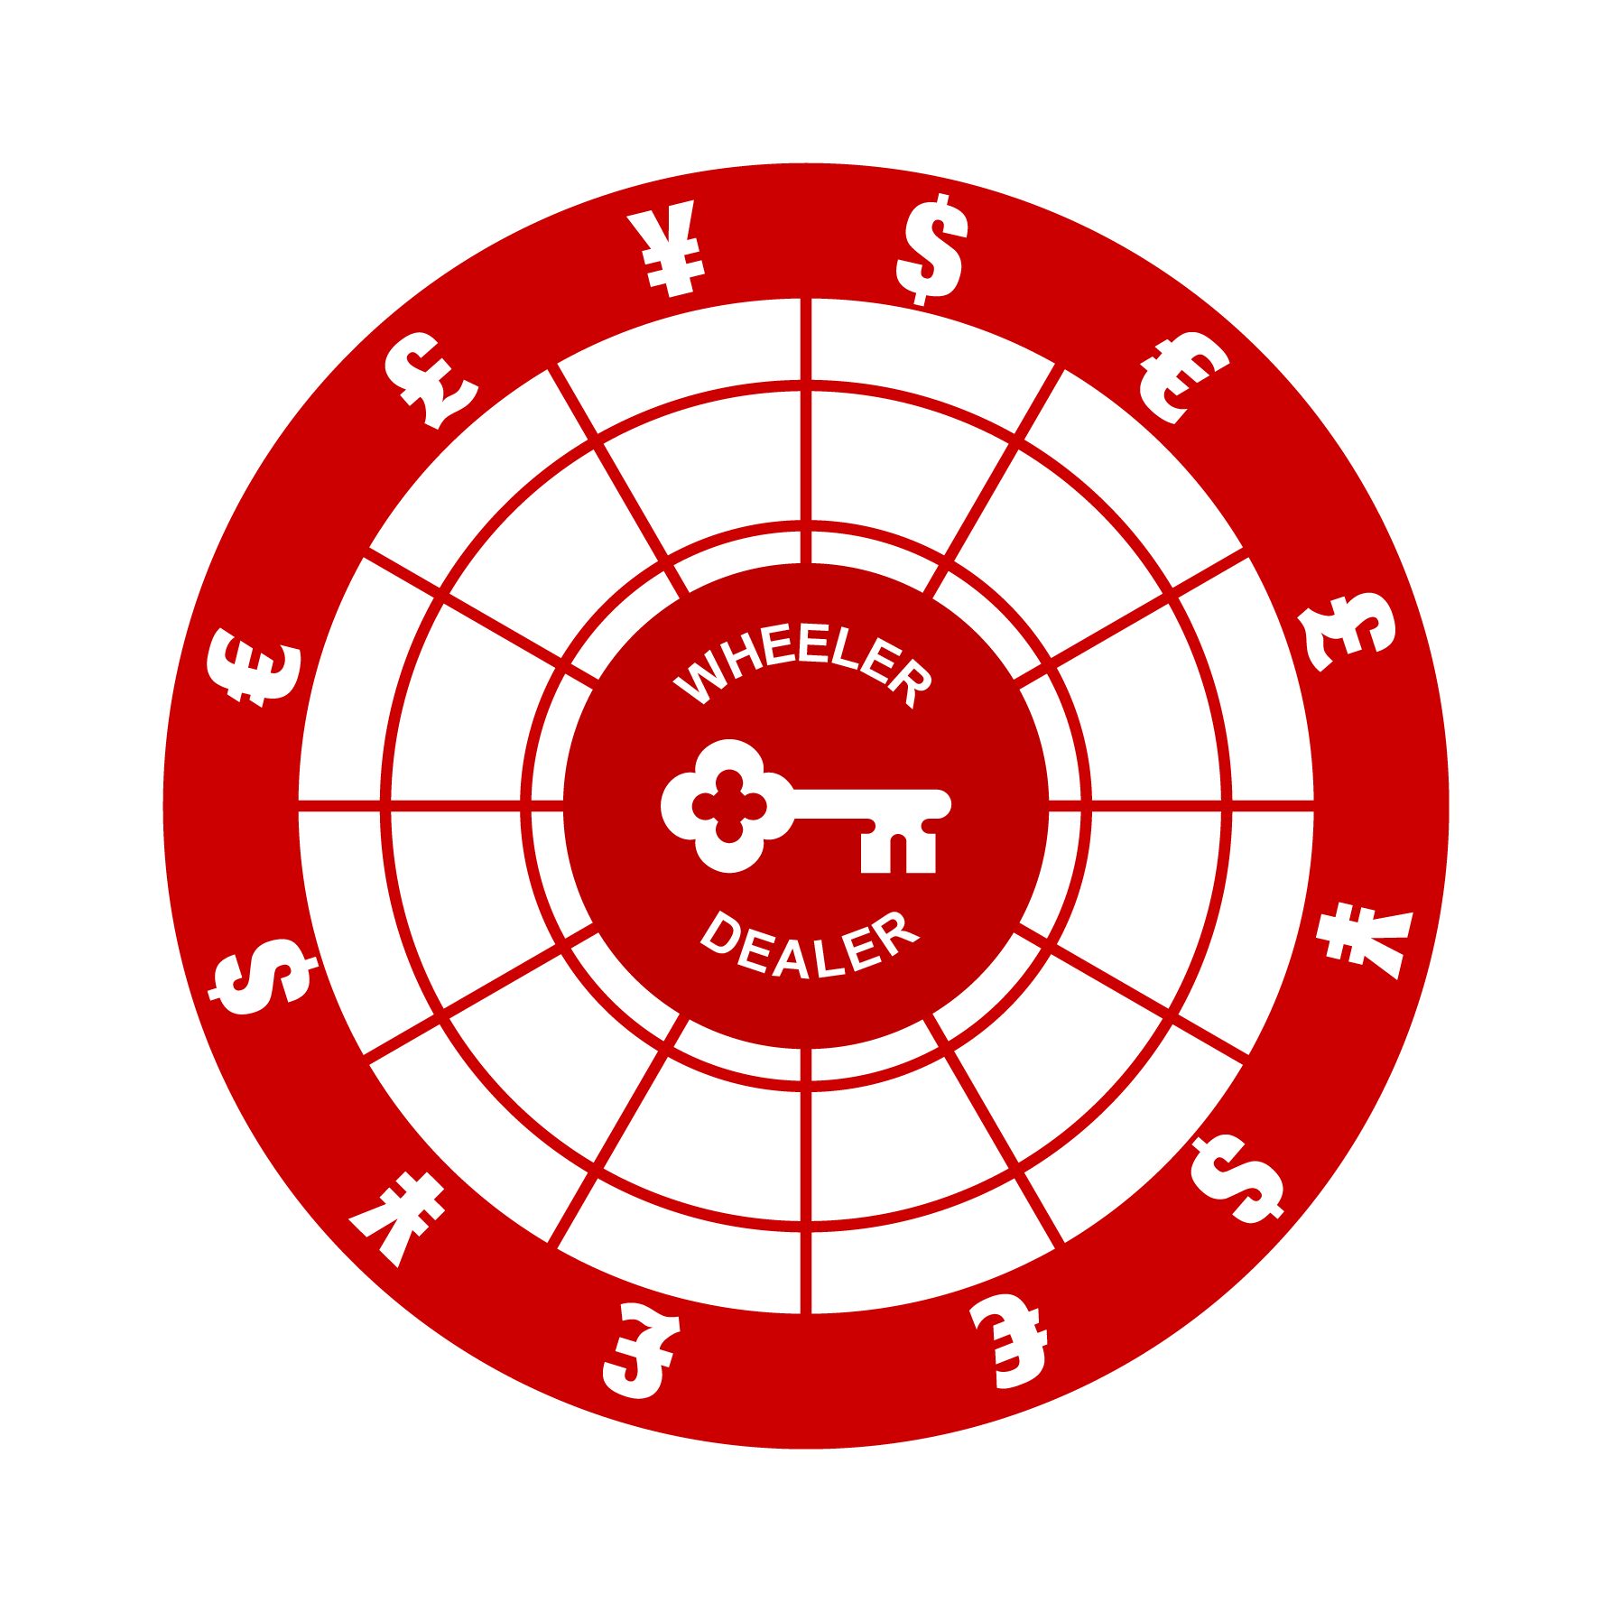
Kahoot!
Go to kahoot.it on your smartphone browser to login
28

Slide 30
Dodd-Frank Swap Dealer Disclaimer:
Discussion Material Preliminary and Subject to Change
This discussion material (“Discussion Material”) is for information purposes only and is not an offering document for any securities or an offer to enter into any transaction(s). Furthermore, this Discussion Material is preliminary and subject to change without notice, and is subject to the final expression of the terms set forth in, and will be superseded in its entirety by, the final terms of definitive transaction documents. The information provided herein is supplied in good faith, based on information we believe, but do not guarantee, to be accurate and complete, and no representation or warranty is made as to its accuracy or the reasonableness of the assumptions contained herein. Furthermore, nothing contained herein shall be relied upon or construed as a promise or representation of past or future performance. All assumptions and information contained herein constitute a judgment only as of the dates specified and are subject to change. This Discussion Material outlines the general structure, and summarizes certain but not all of the characteristics, of the proposed derivatives transaction(s) and is being furnished to you to determine your preliminary interest in entering into derivatives transaction(s) with the general characteristics described herein.
Derivatives can involve a high degree of risk, are not suitable for all clients, and are intended for experienced and sophisticated clients who understand the financial and legal terms of the transactions and who are willing to bear the high economic risk associated with them, which can include, among other risks:
out of pocket losses resulting from changes in market prices, which losses may be multiplied due to leveraging;
loss of all or a substantial portion of the value in the instrument due to unanticipated changes in market prices and conditions, or leveraging or other speculative investment practices;
lack of liquidity in that there may be no secondary market for derivatives instrument(s) and none is expected to develop;
volatility of timing and amount of payments;
restrictions on transferring ownership interests in the derivatives transaction(s);
absence of information regarding valuations and pricing;
legal risk;
counterparty credit risk; and
early termination risk.
Legal, Tax and Accounting Risks
We strongly urge you to consult with appropriate legal, tax and accounting/financial advisors before entering into any derivatives transaction.
KeyBank National Association and each of its affiliates (collectively, “Key”) accept no responsibility for the tax or financial accounting treatment of any derivatives product. Key assumes that, before making a commitment to enter into any derivatives transaction, you will have obtained appropriate tax, accounting, legal and other advice necessary for you to make a fully informed decision about the benefits and risks of such transaction, and you fully understand how to and will properly account for any derivatives product provided by Key, and for any tax lawfully due on the income or gains arising from any such derivatives product. Key is not acting as your fiduciary, advisor or agent. In this regard, by acceptance of this Discussion Material, you acknowledge that you understand that (a) Key is not in the business of providing legal, tax or accounting advice, (b) there may be legal, tax or accounting risks associated with derivatives transaction(s), (c) you should receive legal, tax and accounting advice from advisors with appropriate expertise to assess relevant risks, (d) Key acts as a principal and counterparty in derivative transactions and does not undertake to assess the suitability of derivative transactions or trading strategies involving derivative transactions, and (e) you should apprise senior management in your organization as to the legal, tax and accounting advice (and, if applicable, risks) associated with the derivative transaction(s) described herein and Key’s disclaimers as to these matters.
Securities products are offered by KeyBanc Capital Markets Inc. Member NYSE/FINRA/SIPC. Securities products and services are offered by KeyBanc Capital Markets Inc. and its licensed securities representatives. These products are: Not FDIC Insured; Not Bank Guaranteed; and May Lose Value. KeyBank National Association (KeyBank N.A.) and Key Banc Capital Markets are separate but affiliated companies. Banking products and services are offered by KeyBank N.A. Member FDIC and Equal Housing Lender.
No Performance or Outcome Representation
No representation is made that the derivatives transaction(s) described herein will actually perform as described in any of the illustrative calculations presented herein. Any information and in particular the various calculations contained herein are not intended to predict actual results, which will differ, perhaps substantially, from those illustrated in this Discussion Material. Illustrative performance results are based on mathematical model(s) that calculate those results by using inputs that are based on certain assumptions about a variety of future conditions and events, including future market prices of relevant commodities, and such model(s) cannot take into account all aspects of the applicable transaction’s characteristics under certain conditions. Prospective clients should consider whether the behavior of these transaction(s) should be tested based on different and/or additional assumptions from those included in this Discussion Material.
29

Slide 31
Dodd-Frank Swap Dealer Disclaimer:
KeyBank Swap Dealer Website
At the following website there are several important disclosures for your review when considering entering into a derivative transaction that pertain to material risks, characteristics and conflicts of interest and incentives. www.key.com/SwapDealer
Client Acknowledgements
The derivatives transaction(s) described herein are intended for experienced and sophisticated clients. By going forward with these discussions:
(A) you acknowledge and agree that you are an "eligible contract participant“ as such term is defined in Section 1a(18) of the Commodity Exchange Act, as amended (the “Act”), and the applicable regulations promulgated from time to time in connection therewith (the “Regulations”), or, in each case, under any successor statute or rule, including those enacted pursuant to the Dodd Frank Wall Street Reform and Consumer Protection Act; and
(B) you acknowledge and understand that the instruments and transactions described herein have not been and will not be registered under the Securities Act or the securities laws of any state and may not be offered, sold or otherwise transferred unless an exemption from registration under the Securities Act and applicable state securities laws is available.
Proprietary Rights
This presentation contains material that is protected, individually and collectively, by copyright, trademark or other proprietary rights of Key or others as indicated. The model(s) used in any analysis may be proprietary, making the results difficult or impossible for any third party to reproduce. You may contact your sales representative for detailed explanations of any modeling techniques employed in this Discussion Material. We undertake no obligation to provide you with any updated information reflecting changed circumstances or changed interpretations of the same circumstances.
30

Slide 32

©2020 KeyCorp. KeyBank is Member FDIC.
All credit products are subject to credit approval.

