Slide 1

TIM RUGE
DIRECTOR, PRODUCT MARKETING, PAYCOR

Slide 2

HR Center of Excellence

Slide 3

This Presentation is
Please go to Menti.com

Slide 4

What is the
Based on research of thousands of organizations, Paycor has identified key pillars and a maturity model to help HR professionals improve their current practices.
Through the HR Center of Excellence, HR professionals can extend their reach and unlock their potential via professional advice, inspiration, and action items that will help them make a difference in their organizations.

Slide 5




Our Research
(Over 2,700 Organizations Researched)
Paycor Survey
3rd Party Survey
(Paycor Commissioned)
Aggregated Customer Data
Interviews
Industry
Experts

Slide 6
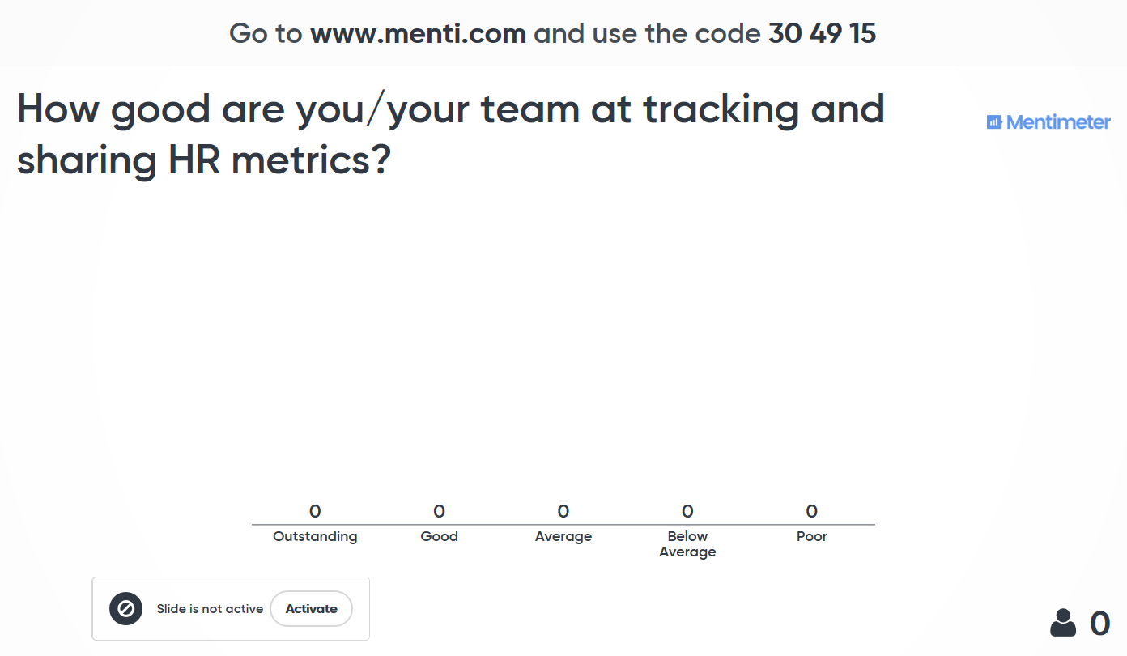

Slide 7



Slide 8






Six Pillars
of HR Excellence

Slide 9
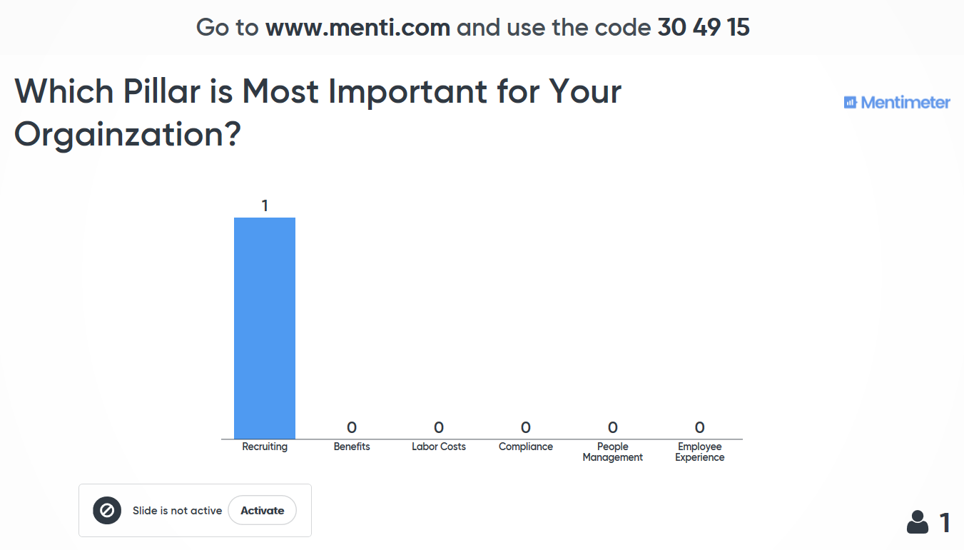

Slide 10

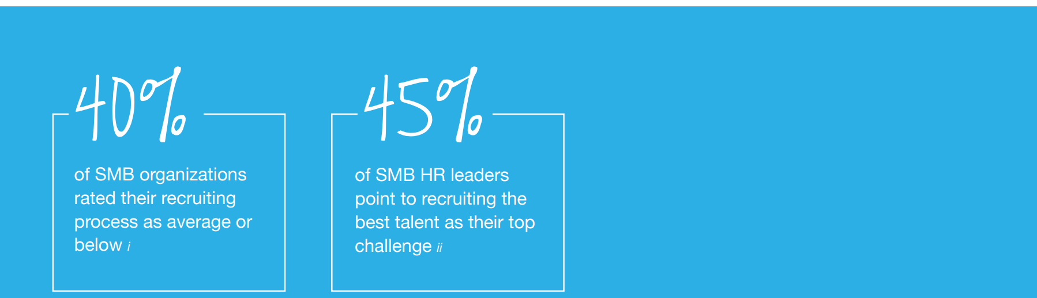
Recruiting
HR’s most important and toughest challenge.

Slide 11



Recruiting
Key Metrics
Average Time to Fill
Total # of Days Job is Open
Total # of Jobs Open
Average = 42 Days*
*(SHRM)
Employee Referral Rate
% Hired from Referrals
All Candidates Hired
Average Cost per Hire
Total Internal/External Costs
Total Candidates Hired
Average = $4,129
*(SHRM)

Slide 12
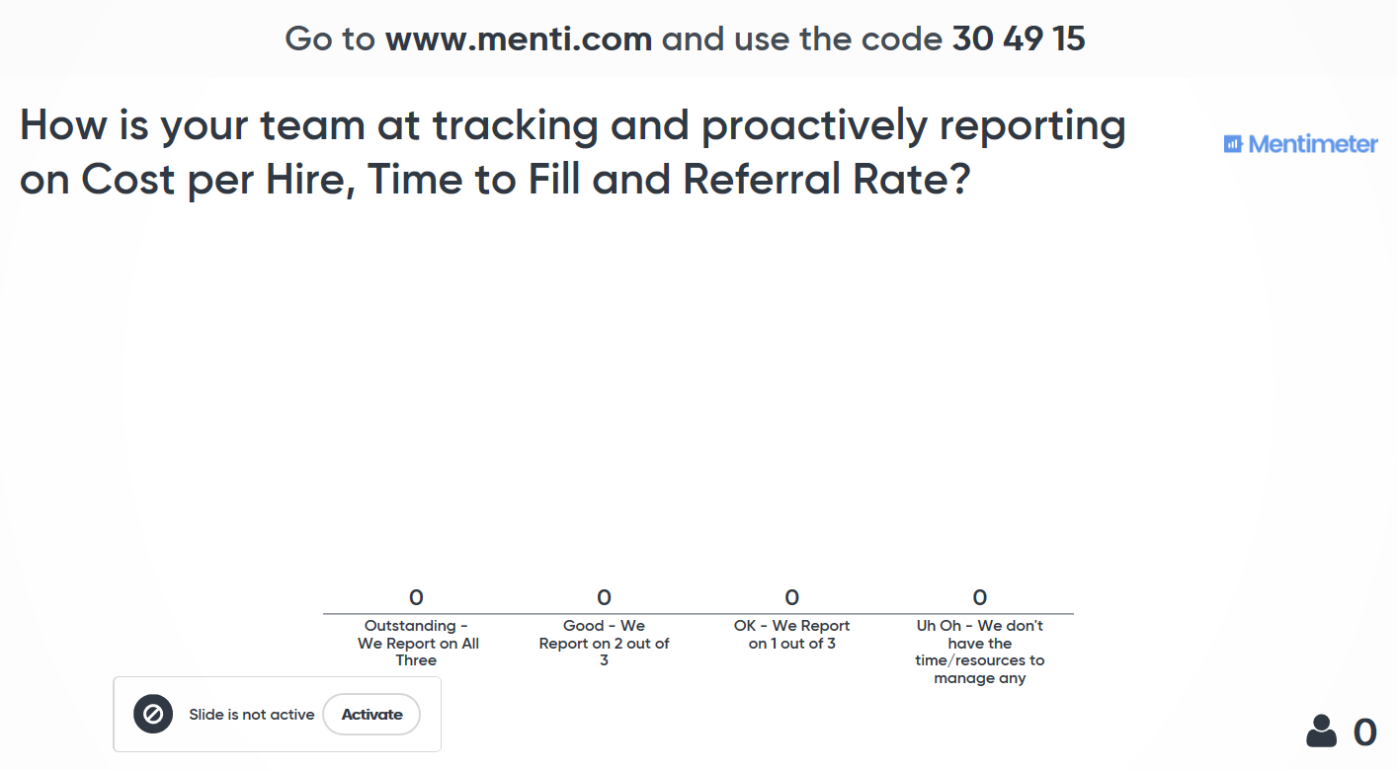

Slide 13
Recruiting
HR’s most important and toughest challenge.
Assess
Optimize
Excel
Current State
No Clear Ownership
Hiring Managers Not Adding Value
No metrics
Ways to Improve
Assign Ownership
Understand Internal Processes
Understand Candidate Experience
Identify Efficiency Opportunities
Current State
Clear Owner
More Efficient
Execs Unaware of Impact
KPIs not defined well or tracked
Ways to Improve
Define KPIs
Align with EC
Current State
Execs understand importance of recruiting
KPIs Agreed to
Regular Cadence of Reporting Results
Ways to Improve
Improve upon your current metrics
Tie KPIs to Exec focuses (Ex: Turnover)
Impacting Other Pillars

Slide 14


Benefits
What (really) motivates your employees?

Slide 15
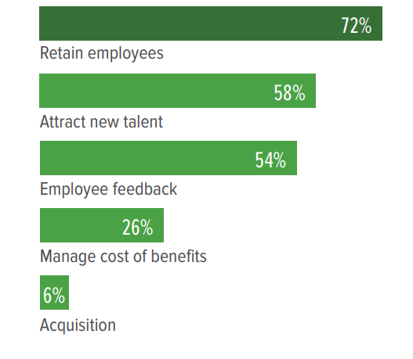
Benefits
Growth in Importance, Growth in Spend
Organizations plans for benefits related spend in 2018
Why increasing in 2018?
6%
Decrease
Overall
32%
Wellness
24%
Health-Related
22%
Professional Dev
16%
Flex Working
14%
Retirement
13%
Leave
12%
*SHRM 2017 Benefits Benchmarking Study

Slide 16


Labor Costs
How are you managing your company’s greatest expense?

Slide 17
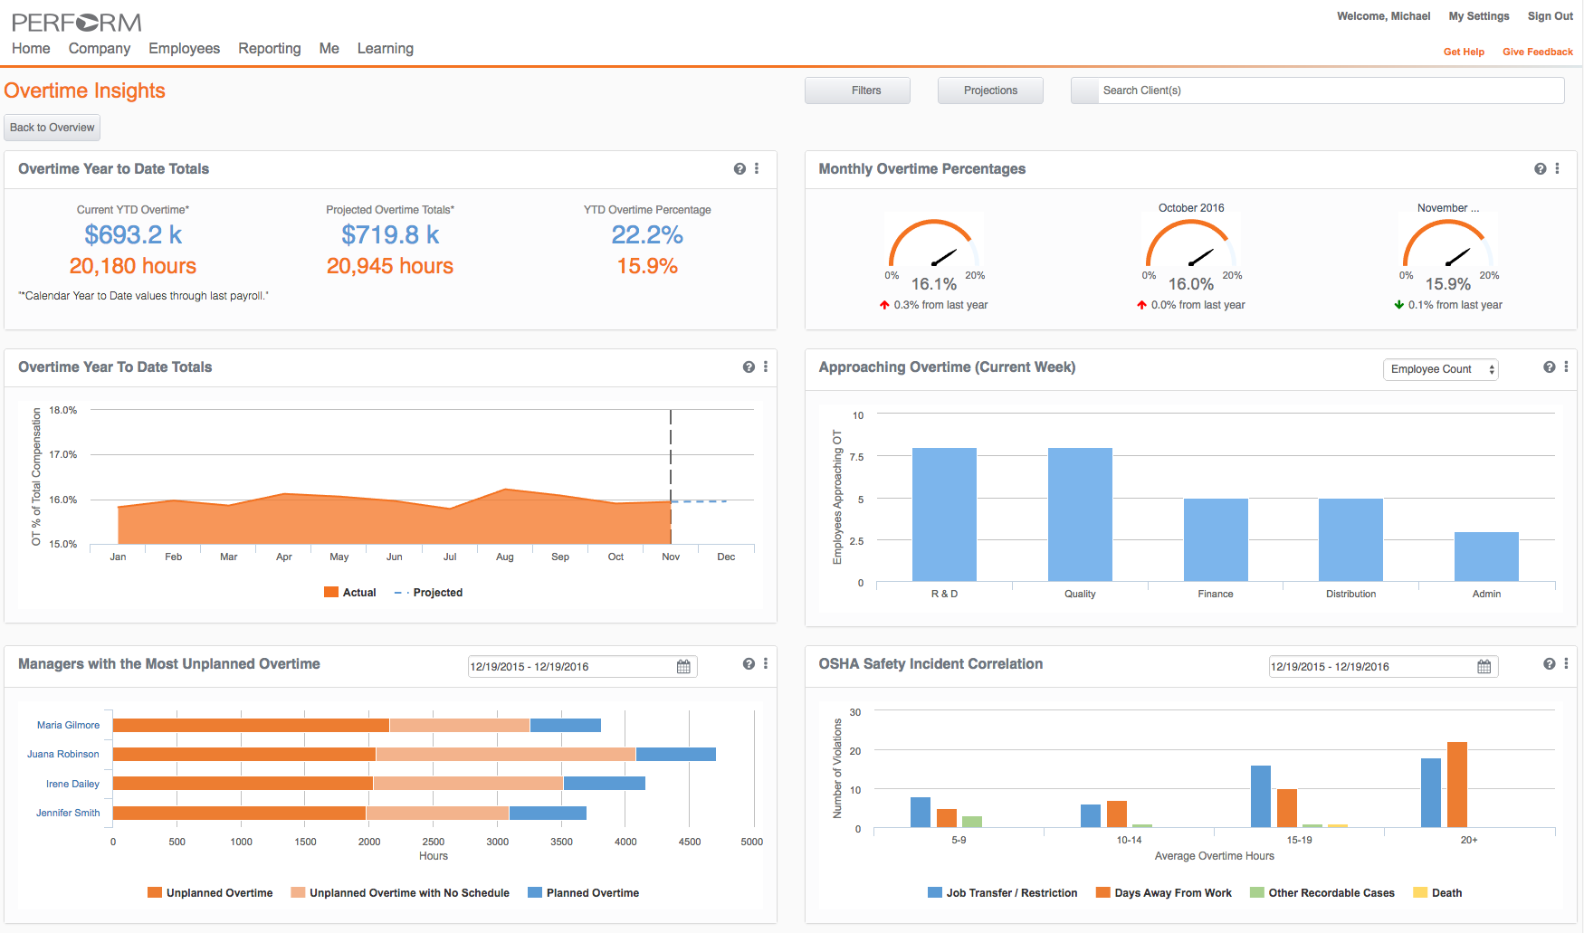

Slide 18



People Management
HR’s biggest challenges come
from managing people.

Slide 19




People Management
Four Key Areas of Focus
Key Metric = Turnover
Onboarding
Performance Management
Learning & Development
Day-to-day Manager & Employee Interactions

Slide 20
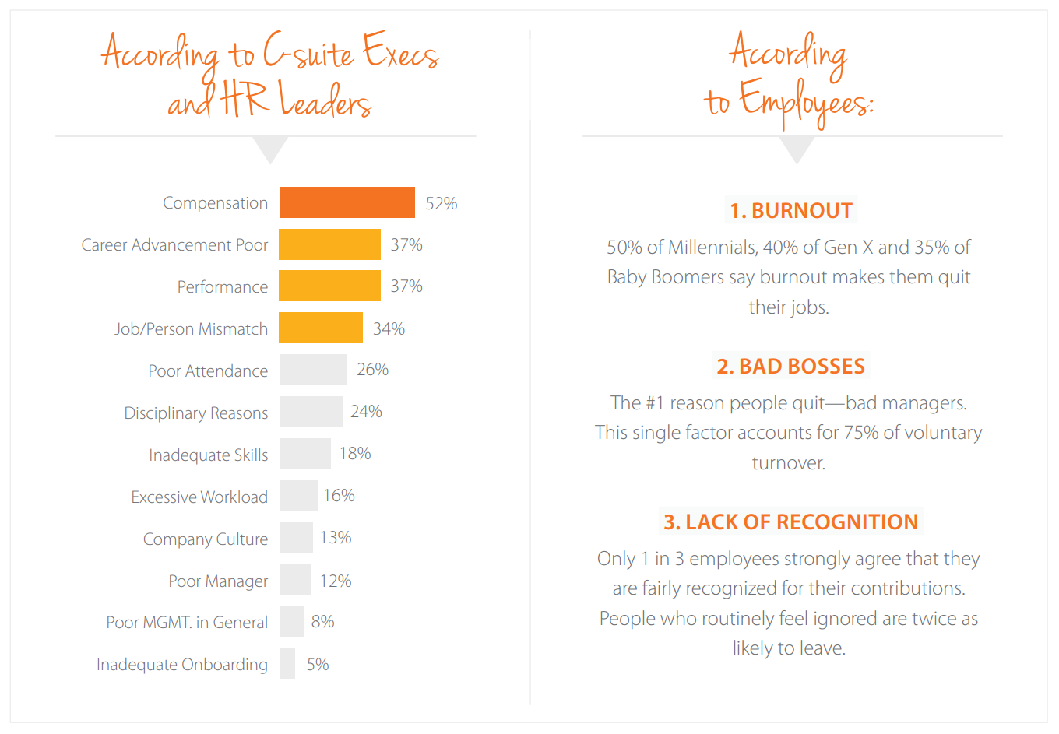

Slide 21

People Management
Adding Up Your Core HR Metrics
Average Time to Fill
40 Days
Average Cost per Hire
$4,000
Turnover Rate
20%
21

Slide 22

People Management
The Impact of Core HR Metrics
250 Employees
50 Employees
Avg = $4,000
Cost per Hire
$200,000 Total

Slide 23
People Management
The Impact of Core HR Metrics
250 Employees
50 Employees
Avg = 40 Days
16,000 Hours
2,000 Days

Slide 24
People Management
The Impact of Core HR Metrics
Average Time to Fill
40 Days
30 Days
Average Cost per Hire
$4,000
$3,500
Turnover Rate
20%
16%
24

Slide 25
People Management
The Impact of Core HR Metrics
Turnover
Cost per Hire
Lost Productivity
50 Employees
40 Employees
$200,000
$140,000
2,000 Days
16,000 Hours
1,200 Days
9,600 Hours

Slide 26
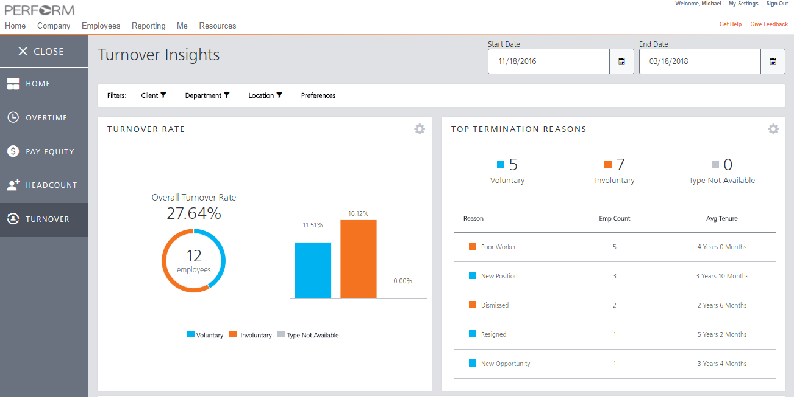

Slide 27


Compliance
The topic everyone wants
to ignore but HR can’t.

Slide 28
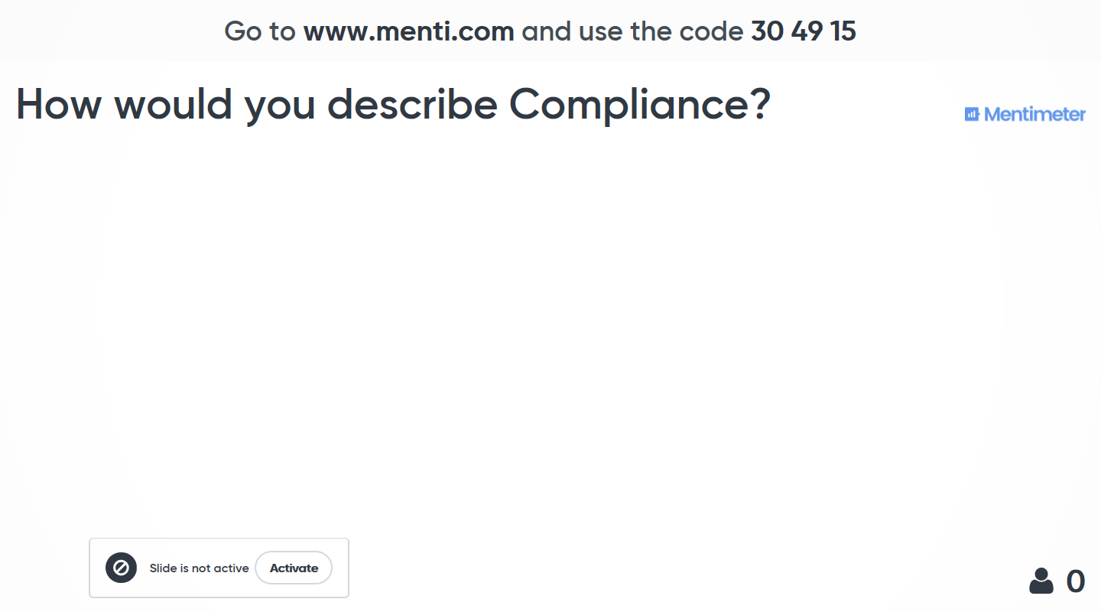

Slide 29





4 Areas of Compliance HR Leaders Need to Know
Recruiting
Hiring
Payroll
People Management

Slide 30
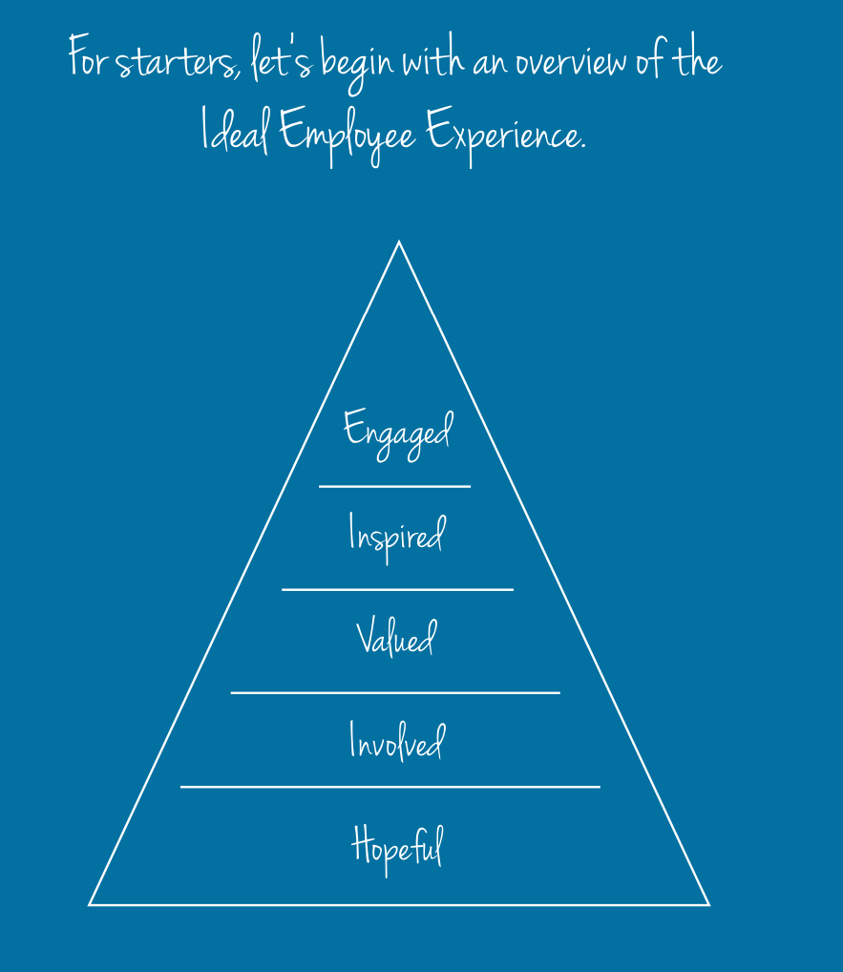
Employee Experience

Slide 31
Employee Experience

Slide 32

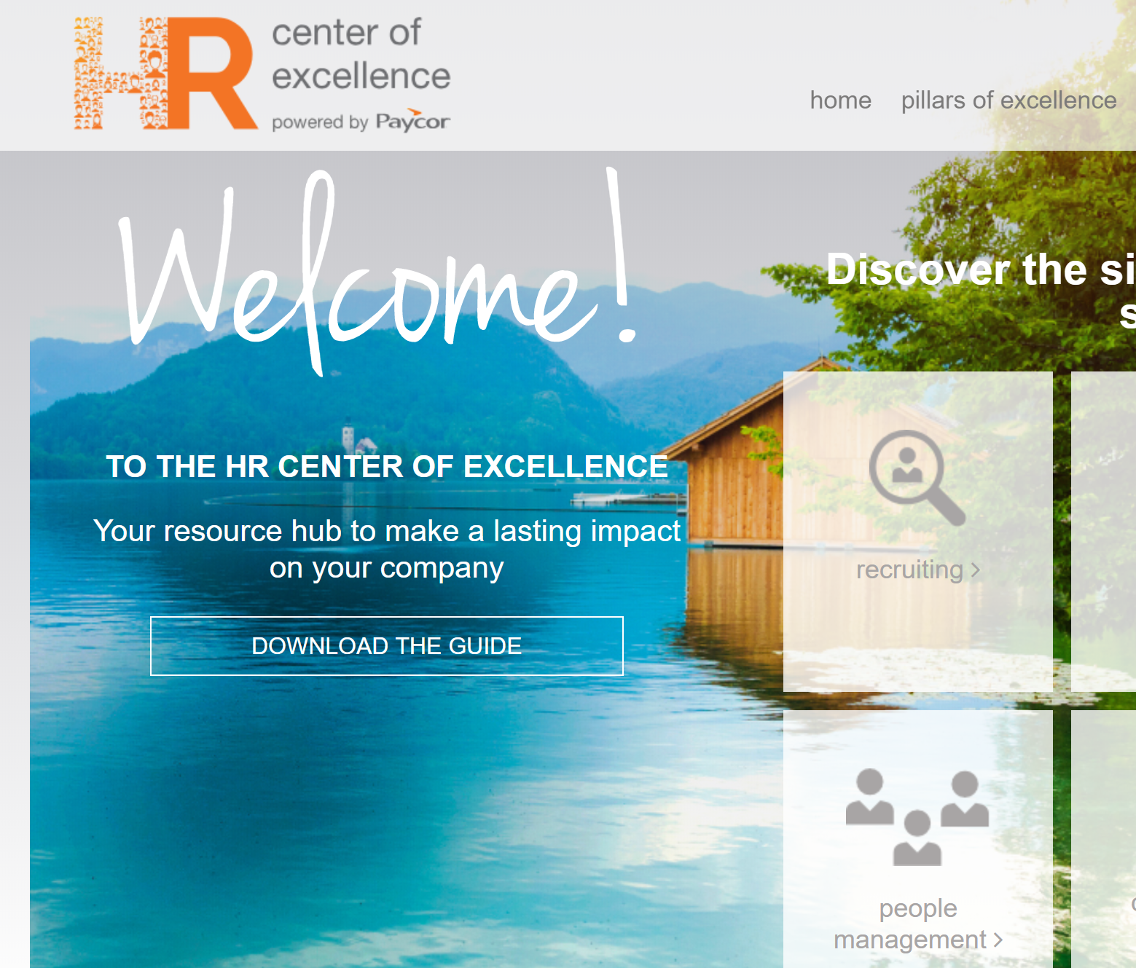
For more information visit Paycor.com/HRCOE
Overview Guide
Benchmark Quizzes
Building an HR Team Guide
Articles/Advice by Pillar

