Slide 1
Welcome!
Southwest Ohio Association for Financial Professionals

Slide 2
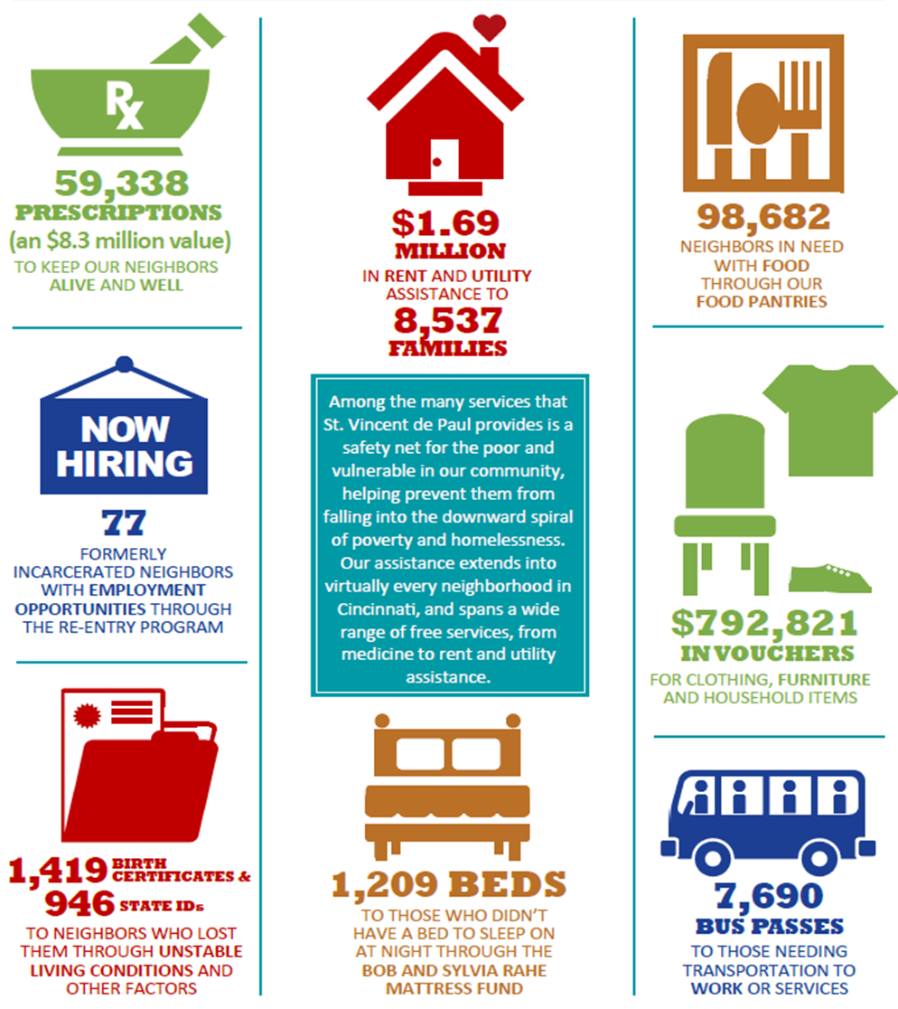

Slide 3
Structure
Three entities
Society, including 56 parish-based volunteer groups (conferences)
Charitable Pharmacy
Stores

Slide 4
Finance Committee
To assist the Board in its oversight of financial affairs for all St. Vincent de Paul – Cincinnati entities.
Meets quarterly to review:
financial statements
investments position and performance
cash position and forecast
Notes:
Members include both board members and non-board members. Include board treasurer (who serves as committee chair), a representative from Pharmacy Board, Board chair, public accounting w/experience w/non-profits, accountants in industry, investment experts. Is responsible for overall financial condition, financial planning, operational and capital budgeting, debt structure, investments (including maintenance of investment policy), annual audits and tax filings, and any other financial matters.

Slide 5
Cash position
Cash on hand
Operating reserve – specified time period based on current year budget
Cash restricted by donors
Capital budget – board designated
Available unrestricted cash
Notes:
Cash on hand held in checking accounts, savings account in several banks, money market accounts, and brokerage accounts. We have also purchased t-bills and CDs for short-term investing. We also maintain investments (both general use and endowments) managed by third parties according to our investment policy.

Slide 6
Budgeting
Staff prepares and submits proposed budget
Finance Committee reviews and approves
Board adopts at a full board meeting
(includes summary of budget assumptions)

Slide 7
Budgeting Process
Proposed initiatives for the coming year by operational area:
Create or expand programming
Additional staff needs
Activities necessary to meet goals of strategic plan
Capital expenditures
Proposed budget by line item for each operational area
Consolidate by entity, funding initiatives as resources allow for a balanced budget

Slide 8
FY 18 Total Revenue: $35,264,838

Slide 9
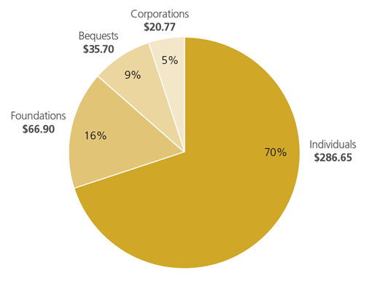
FY 18 Development Revenue $3,098,557
St. Vincent de Paul
Sources of Funding
National
Sources of Funding
(in billions of dollars)
Source: Giving USA 2018

Slide 10
FY 18 Total Expenses: $31,401,684

Slide 11
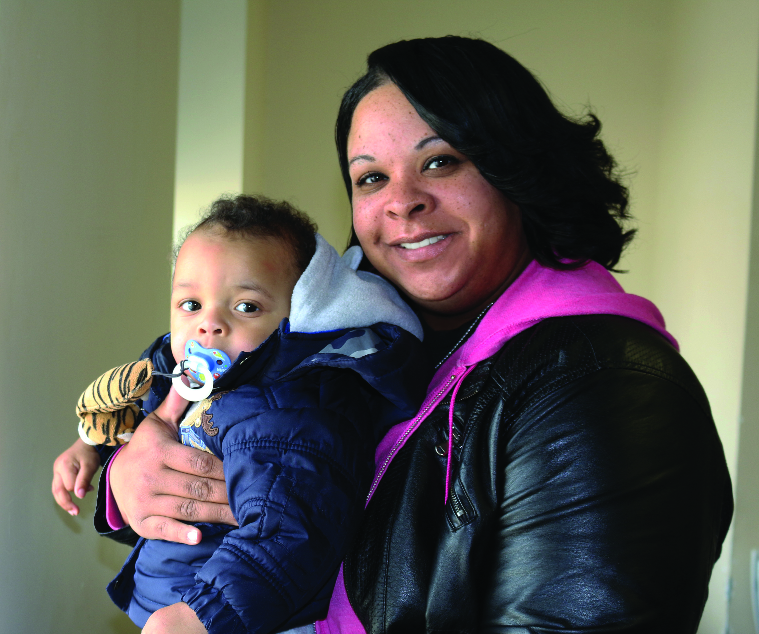
Thank You!
Notes:
Tell story of Nacrehsa – Ny’el (5, old soul, loves hard candies, hard of hearing) and Mikha (11, cheerleader, takes care of Ny’el) – high risk pregnancy, due in January, had to stop working. Needed help for Christmas.

Slide 13
