Slide 1
U.S. Bank Information & Cyber Security Services Welcomes The South West Ohio Association of Financial Professionals
Presenter: Manager of Information Security, AVP Charles Banks
April 8th, 2020
This information has been obtained from sources believed to be reliable, but we cannot guarantee its accuracy or completeness.

Slide 2
What does a strong Information & Cyber Security strategy look like?
Risk and Resilience should be cornerstones of your cyber program.
Risk-based
Adaptively prioritize and implement countermeasures and controls based on risk and predictive analysis.
Intelligence-driven
Multisource intelligence through partnerships, advanced analytics, automation, and threat detection and response.
Customer-centric
Align with and enable the business with frictionless user experiences.
Resilience
Reduce time to detect, respond to and remediate a problem to return to normal operations.

Slide 3
Our engagement audiences and our focuses
U.S. Bank internal business lines – What are the good cyber/information security behaviors I should use everyday in my job at U.S. Bank?
U.S. Bank current/potential clients – Why should I have confidence that U.S. Bank is doing everything possible to protect my digital information and assets?
U.S. Bank local community footprint – What are cyber civics and how do I become a literate and responsible digital citizen? What education is required, and what are the career opportunities available in cyber security?

Slide 4
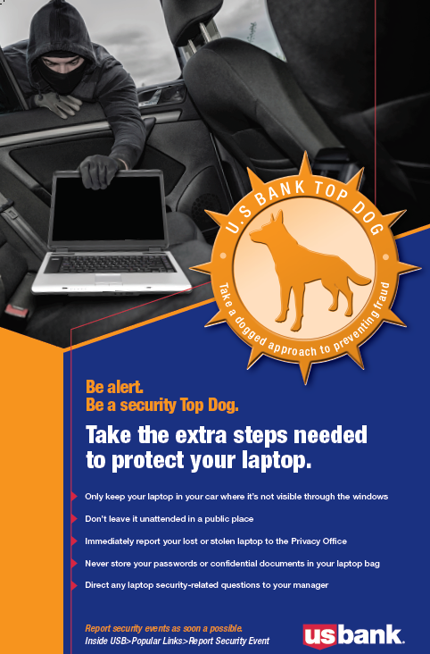
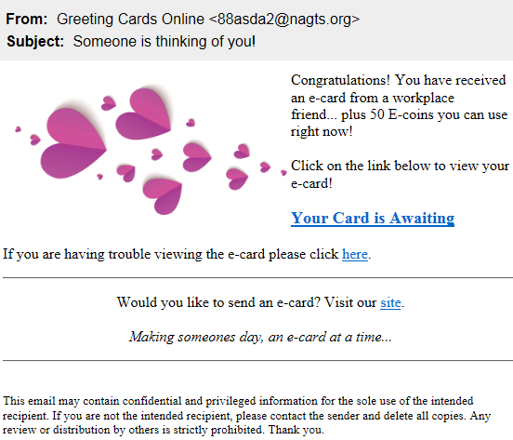
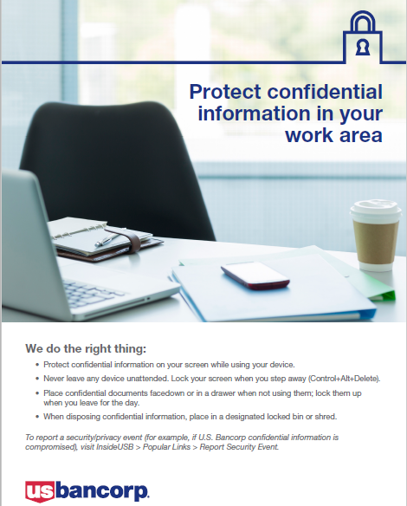
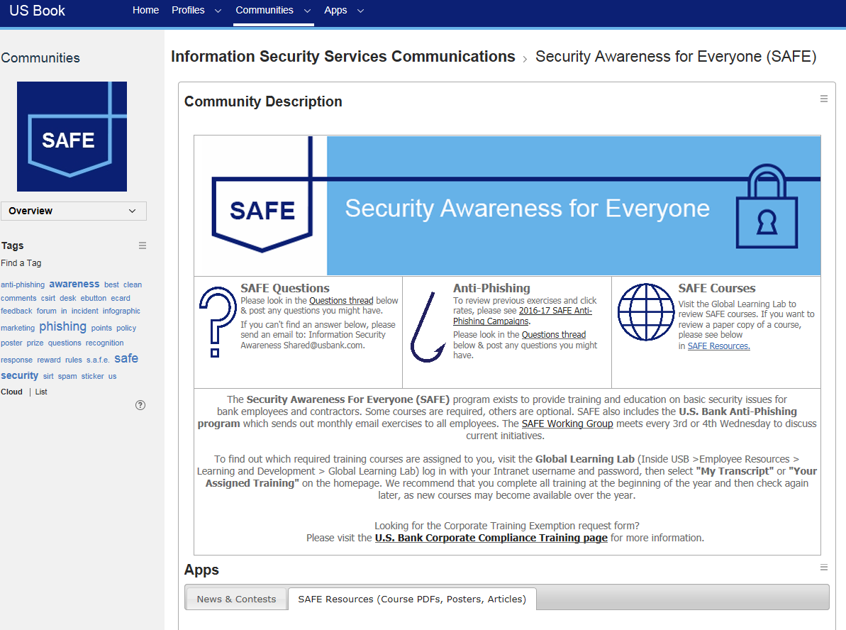
Phishing Exercises
Posters
Formal Training
Hacktivists
Data Loss
Insider
Nation-State
Cybercriminal
Internal Social Network
Impact of Awareness
A W A R E N E S S
T H R E A T S
Notes:
The Bank is a member of and involved in information security working groups through the following organizations:
Securities Industry and Financial Markets Association (SIFMA)
Financial Services Information Sharing and Analysis Center (FS-ISAC)
Financial Services Sector Coordinating Council (FSSCC)
American Bankers Association (ABA)
The Clearing House (TCH)
Financial Services Roundtable Business Information Technology (FSR-BITS) Committee
National Cyber-Forensics and Training Alliance (NCFTA) U.S. Chamber of Commerce
Infragard
U.S. Bank receives alerts, reports and briefings from various government agencies including DHS, FBI and Treasury via FS-ISAC. Products received include:
DHS and FBI Joint Indicator Bulletins (JIBs)
DHS’s United States Computer Emergency Readiness Team (US-CERT) / Industrial Control Systems Computer Emergency Readiness Team (ICS-CERT) and Cyber Information Sharing and Collaboration Program (CISCP) Indicator Bulletins (IBs)
US-CERT Malware Initial Findings Reports (MIFRs)
US-CERT Malware Analysis Reports
U.S. Bank submits RFIs to the federal government via FS-ISAC National Cybersecurity and Communications Center (NCCIC) liaisons.

Slide 5
Phishing Exercises
Posters
Hacktivists
Data Loss
Formal Training
Insider
Nation-State
Cybercriminal
Impact of Awareness
Internal Social Network
A W A R E N E S S
T H R E A T S
Notes:
The Bank is a member of and involved in information security working groups through the following organizations:
Securities Industry and Financial Markets Association (SIFMA)
Financial Services Information Sharing and Analysis Center (FS-ISAC)
Financial Services Sector Coordinating Council (FSSCC)
American Bankers Association (ABA)
The Clearing House (TCH)
Financial Services Roundtable Business Information Technology (FSR-BITS) Committee
National Cyber-Forensics and Training Alliance (NCFTA) U.S. Chamber of Commerce
Infragard
U.S. Bank receives alerts, reports and briefings from various government agencies including DHS, FBI and Treasury via FS-ISAC. Products received include:
DHS and FBI Joint Indicator Bulletins (JIBs)
DHS’s United States Computer Emergency Readiness Team (US-CERT) / Industrial Control Systems Computer Emergency Readiness Team (ICS-CERT) and Cyber Information Sharing and Collaboration Program (CISCP) Indicator Bulletins (IBs)
US-CERT Malware Initial Findings Reports (MIFRs)
US-CERT Malware Analysis Reports
U.S. Bank submits RFIs to the federal government via FS-ISAC National Cybersecurity and Communications Center (NCCIC) liaisons.

Slide 6
Navigating the cyber risk landscape

Slide 7
Our disclaimer
This presentation is meant to educate you — not to scare you.
But we do want you to take action when you leave.

Slide 8
Cyber-physical “Internet of Things”
By 2020:
50 billion devices will be connected with online data volume increasing 50x
Source: Forbes, Vice, Cisco IBSG, University of Michigan, ABC News, Qmed, Network World
Notes:
This number gives security analysts nightmares

Slide 9
What happens in an Internet minute in 2020?
Netflix: 695,000 hours of video watched.¹
Facebook: 3.3 million pieces of content shared.²
Ads: 10 million ads displayed.³
Amazon: $283,751 in sales.⁴
YouTube: 4.5 million videos watched.⁵
Twitter: 481,000 tweets.⁶
Instagram: 347,000 Scrolling.⁷
Apps: 390,422 app downloads.⁸
Google: 3.8 million searches.⁹
Pinterest: 9,800 articles pinned.¹⁰
SnapChat: 2.1 million Snap Created¹¹
IM: 34.7 million instant messages (MIM) sent.¹²
Source: What Happens in an Internet Minute?, 2016. http://www.excelacom.com/resources/blog/2016-update-what-happens-in-one-internet-minute;1Netflix Shareholder Report, Jan. 19, 2016;2”What Happens Online in 60 Seconds”, Smart Insights Feb. 6, 2017;3”2013 U.S. Digital Future in Focus Whitepaper”, Feb. 14, 2013;4Amazon Quarterly Income Statement, Year Ending Dec. 31, 2016;5YouTube Press Statistics, Apr. 2014;6Internet Live Stats, 2016;7Smart Insights, Feb. 2017;8TUNE, Global Mobile 2016;9Smart Insights, Feb. 2017;10Big Data, 2016;11Pandora Monthly Audience Metrics Press Releases, Jan. 2013-Dec. 2013;12”Technology, Media & Telecommunications Predictions 2014”, Deloitte Touche Tohmatsu Limited, 2014.

Slide 10
The Global Economic Impact of Cybercrime
Approximately $600 billon,
Nearly one percent of global GDP, is lost to cybercrime each year.
Source: Forbes, Vice, Cisco IBSG, University of Michigan, ABC News, Qmed, Network World
Notes:
This number gives security analysts nightmares

Slide 11
The financial challenge
The 2019 Cost of a Data Breach Study: Global Overview recruited and interviewed 2,200 individuals from 477 organizations worldwide.
Average number of lost records per breach: 26,000
Average cost of a data breach:
$3.92M
Average cost per lost or stolen record: $148
FBI Office of Private Sector Slicksheet, “Costs Associated with cyber Intrusions”
Notes:
The faster a data breach can be identified and contained, the lower the costs. Incident response teams and the extensive use of encryption reduce costs.
The extensive use of encryption reduced cost by $13 per capita.
Organizations with senior-level leaders such as a Chief Privacy Officer (CPO) or CISO directing initiatives to improve customer trust in the guardianship of their personal information reduces the turnover of customers and, therefore, the cost of the breach.
Having established Business Continuity Management (BCM) reduces the cost of a data breach.

Slide 12
Who’s behind the breaches?
Breach: an incident that results in the confirmed disclosure —not just potential exposure — of data to an unauthorized party
Perpetrated by outsiders
Featured multiple parties
73%
2%
Breaches carried out by organized criminal groups
Involved internal actors
28%
50%
Breaches involved actors identified as nation-state or state affiliated
Involved partners
2%
12%
Source: Verizon 2018 Data Breach Investigations Report, 11th edition

Slide 13
Rapidly evolving threats — Current Landscape
Fraudsters
Hacktivists
Nation-states
Theft
Disruption
Destruction
Notes:
Rapidly evolving threats — motivational shifts
Fraudsters/Thieves: Cyber criminals are growing increasingly sophisticated. From stealing credit card data and PII (personal identity information) to extortion style attacks like ransomware (“We have infected your system and locked your data. If you want to access your data, you must pay us X bitcoin”), they are hitting every industry and government.
Hacktivists: They want to embarrass your organization. They are less sophisticated than the major criminal gangs, but look for weak spots like externally hosted websites to deface. Sometimes they are in the U.S., groups like Anonymous. Sometimes they are foreign groups like ISIS or Syrian Electronic Army eager to say they’ve successfully attacked anything in the U.S.
Nation-States: These organizations do everything to America from stealing intellectual property to launching distributed denial of service attacks to destructive malware, like we all saw happen to Sony.

Slide 14
Workforce development
The cybersecurity profession is expected to grow at a rate of 36.5% through 2022.
The global cyber workforce gap in 2019 was estimated to be 4.07 million.
The U.S. cyber workforce gap in 2019 was nearly 500,000.
The global cyber workforce needs to
grow by 145% to meet demand.
SOURCES: http://www.forbes.com/sites/stevemorgan/2016/01/02/one-million-cybersecurity-job-openings-in-2016/; http://cybersecurityventures.com/cybersecurity-market-report/; https://www.isc2.org/-/media/ISC2/Research/2019-Cybersecurity-Workforce-Study/ISC2-Cybersecurity-Workforce-Study-2019.ashx?la=en&hash=D087F6468B4991E0BEFFC017BC1ADF59CD5A2EF7
Notes:
“…nearly 805,000 cybersecurity professionals are estimated to be working in the U.S. The calculation was then applied to 10 other major economies where sufficient survey data was available. Together, these workforce estimates total 2.8 million.”
65% of organizations represented have a shortage of staff dedicated to cybersecurity
“the cybersecurity workforce needs to grow by 62% in order to meet the demands of U.S. businesses” today
(https://www.isc2.org/-/media/ISC2/Research/2019-Cybersecurity-Workforce-Study/ISC2-Cybersecurity-Workforce-Study-2019.ashx?la=en&hash=D087F6468B4991E0BEFFC017BC1ADF59CD5A2EF7)
“According to ISACA’s State of Cybersecurity 2019 Report, 69 percent of organizations have understaffed cybersecurity teams.”
(https://insights.dice.com/2019/10/15/cybersecurity-labor-shortage/)

Slide 15
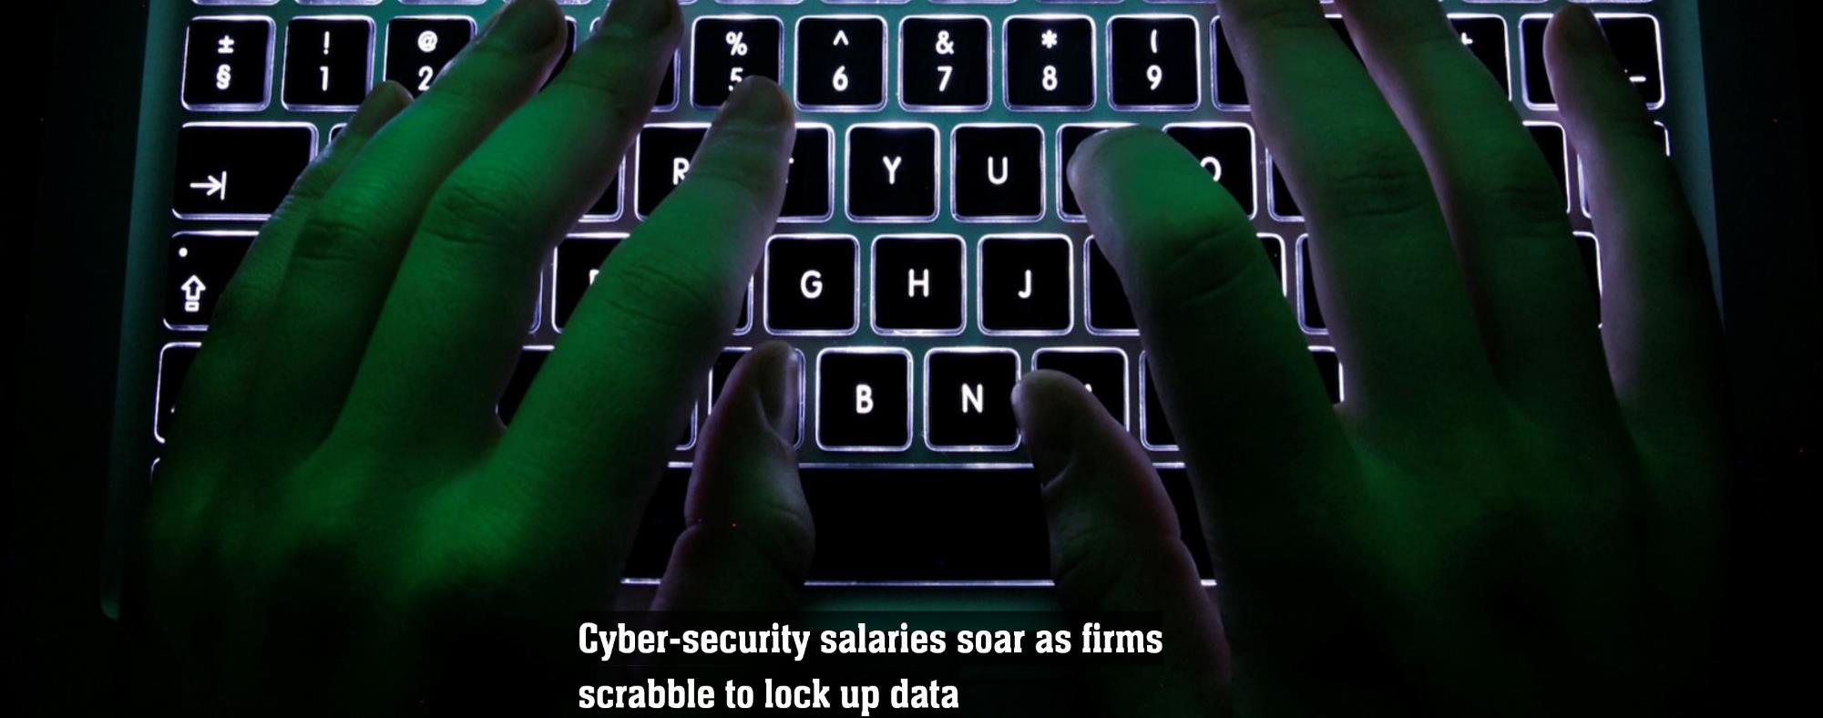
The Cost of Information Security

Slide 16
Security Awareness for Everyone (S.A.F.E.)
The largest areas of Cyber Security compromise are caused by a lack of security minded HUMAN BEHAVIORS.
Which Cyber Security exploit takes advantage of this the most?

Slide 17
The Results of
Business Email Compromise
66% of malware is installed via malicious email attachments*.
*Verizon’s 2017 Data Breach Investigations Report
Notes:
ABBIE
Smishing – SMS/Text message
Vishing – voicemail

Slide 18
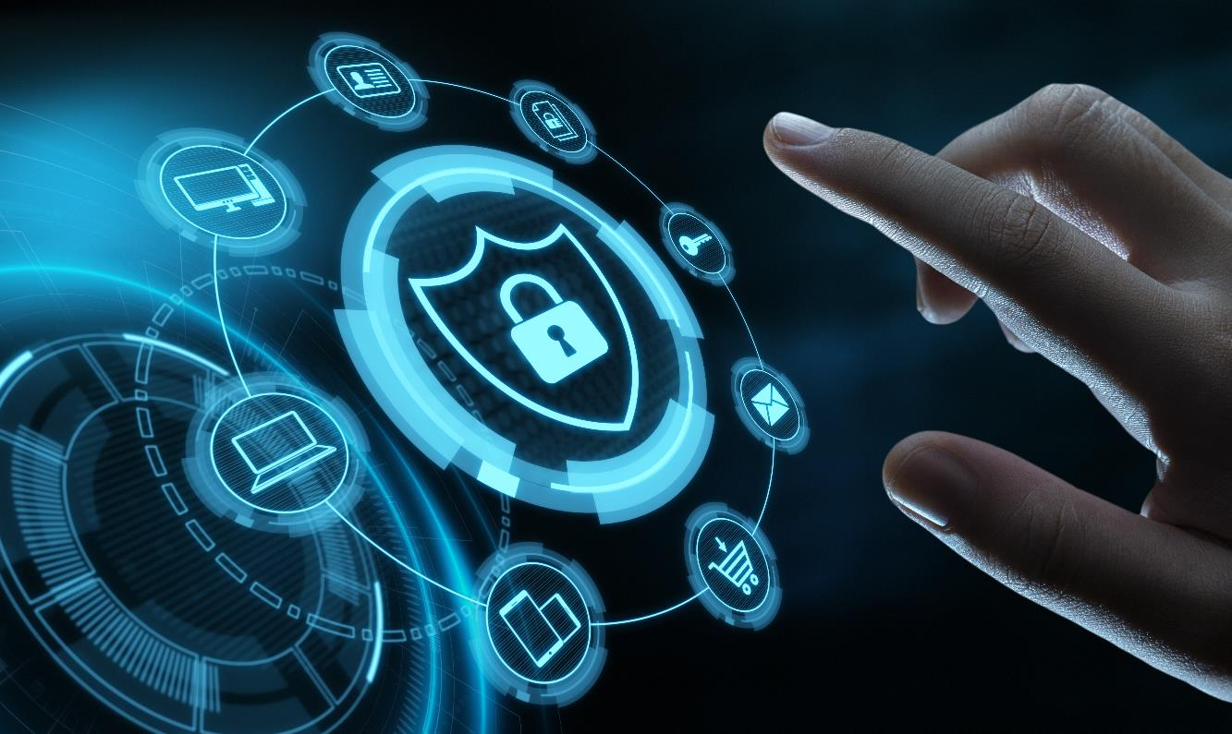
Business email compromise (BEC) is on the rise
$12.5B
total and potential losses globally since 2013
24K
complaints reported to the FBI in 2019
$1.7B
adjusted losses during 2019
1/3rd
of cases highlight a payment through wire transfer
11%
of all email fraud attacks use ‘fake email chain’ messages
2019 Internet Crime Report, FBI: https://pdf.ic3.gov/2019_IC3Report.pdf;
Source: InfoSec Magazine - https://www.infosecurity-magazine.com/news/bec-attacks-jumped-17-last-year/
Notes:
From the FBI:
BEC/EAC is a sophisticated scam targeting both businesses and individuals performing a transfer of funds. The scam is frequently carried out when a subject compromises legitimate business email accounts through social engineering or computer intrusion techniques to conduct unauthorized transfers of funds. BEC/EAC is constantly evolving as scammers become more sophisticated.
The FBI has reported that Business Email Compromise is on the rise globally, since the Federal Agency began tracking BEC in 2013. Cybercriminal organizations are targeting companies in every U.S. state and in more than 100 countries around the world. There have been billions of dollars in losses so far, and that price tag is expected to grow. Here are some sobering facts about BEC.
In 2019, the IC3 received 23,775 Business Email Compromise (BEC) / Email Account Compromise (EAC) complaints
Adjusted losses of over $1.7 billion in 2019
In 2013, BEC/EAC scams routinely began with the hacking or spoofing of the email accounts of chief executive officers or chief financial officers, and fraudulent emails were sent requesting wire payments be sent to fraudulent locations.
Over the years, the scam evolved to include compromise of personal emails, compromise of vendor emails, spoofed lawyer email accounts, requests for W-2 information, the targeting of the real estate sector, and fraudulent requests for large amounts of gift cards.
In 2019, the IC3 observed an increase in the number of BEC/EAC complaints related to the diversion of payroll funds. In this type of scheme, a company’s human resources or payroll department receives an email appearing to be from an employee requesting to update their direct deposit information for the current pay period. The new direct deposit information generally routes to a pre-paid card account.
https://pdf.ic3.gov/2019_IC3Report.pdf

Slide 19
Recognizing phishing
Look at overall email message
Is it from an external email address? Is it unsolicited? Does the email address look legit, but is slightly “off” (ex: linkedin.com)? Does it require urgent or immediate action?
Look at links
Look out for spoofed links to seemingly legit sites. Hover over links to see the actual destination – does it match the link? Check the country code in the domain – does it match the sender’s info?
Look at attachments/files
Beware of attachments which can contain embedded malware or launch malware. Don’t open or download!
Know how to report suspicious emails within the company.
Don’t delete suspicious emails before reporting them. It’s important to investigate potential threats.

Slide 20
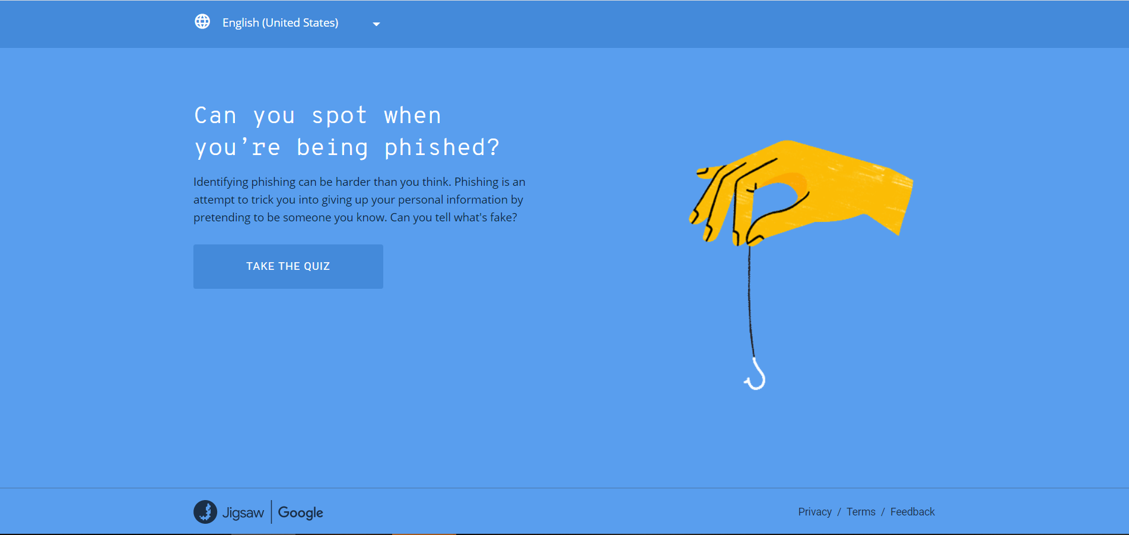

Slide 21
Be on the alert to spot phishing
Things to look out for:
Focused twists:
“Phishy” company emails
Requests for credentials or account information
“Spear phishing”
Executives = “whales”
Adding a telephone component
1. Phishing email
2. Bait taken
3. Credentials stolen
A fraudulent email is sent masquerading as legitimate.
Phisher tries to acquire victim’s login credentials or account information.
If successful, the phisher can use login credentials or account information for their purposes.
Notes:
Look out for:
Phishing emails look like they are coming from a reputable source. They are an attacker masquerading as someone else.
Some phishers attempt to get you to reveal your personal information in order to access sensitive data.
Once the attacker has login credentials or account information, they can use it for their own nefarious purposes.
Others want you to open a file or click a link, which downloads malicious software onto your network.
“Spear phishing” is a more targeted and sophisticated attack.
Executives are what we call, “whales.”
Increasingly seeing a telephone component to go with the emails.
Think twice before you click, be suspicious.
Mouse over the sender’s name. Does the email address look right?

Slide 22
Spear Phishing Attack

Slide 23
The “Executive Masquerade”
Spoof
Masquerade
Funds Transferred
The email accounts of high-level business executives (Chief Financial Officer, Chief Technology Officer, etc.) are compromised.
The account may be spoofed or hacked.
A request for a wire transfer from the spoofed account is made to a second employee responsible for processing requests.
In some instances, the request is sent directly to the financial institution with instructions to urgently send funds to bank “X” for reason “Y.”
The victimized employee processes the fraudulent request.
The fraudster receives the wire transfer.
Sources: 2017 FBI PSA: https://www.ic3.gov/media/2017/170504.aspx;
U.S. Bank Financial IQ – Minimize Risk: https://financialiq.usbank.com/index/improve-your-operations/minimize-risk.html
Notes:
Business Executive Receiving or Initiating a Request for a Wire Transfer
The email accounts of high-level business executives (Chief Financial Officer, Chief Technology Officer, etc.) are compromised. The account may be spoofed or hacked. A request for a wire transfer from the compromised account is made to a second employee within the company who is typically responsible for processing these requests. In some instances, a request for a wire transfer from the compromised account is sent directly to the financial institution with instructions to urgently send funds to bank “X” for reason “Y.” This particular scenario has been referred to as “CEO Fraud,” “Business Executive Scam,” “Masquerading,” and “Financial Industry Wire Frauds.”

Slide 24
The email account may be HACKED or the identity of the executive may be SPOOFED.
01
02
Email account of high-level business executive becomes COMPROMISED.

Slide 25
An URGENT request from a seemingly trusted source is sent to the financial institution with instructions to send funds from Bank “X” to Bank “Y”.
03
04
Request for a WIRE TRANSFER from the HACKED account is made to the employee responsible for processing requests.

Slide 26
05
The FRAUDSTER RECEIVES the wire transfer.
06
The victimized employee PROCESSES the fraudulent request.

Slide 28
Prevention strategies and response

Slide 29
Understand recent trends in BEC
W-2/PII Data Theft
Tech Support Fraud
Targeting Real Estate
The requests appear to coincide with the U.S. tax season.
Most popular method remains impersonating an executive within the same organization.
Individual taxpayers may be the targeted, but criminals have evolved their tactics to focus on mass data thefts.
86% increase in losses from 2016 to 2017.
Criminals may pose as a technical support representative offering to resolve such issues as a compromised e-mail or bank account, a virus on a computer, or to assist with a software license renewal.
Initial contact can occur through telephone, ads, pop-up messages, locked screens, emails, and more.
Targets all participants in real estate transactions, including title companies, buyers, sellers, agents, and lawyers.
1,100% increase in the number of complaints from 2015 to 2017.
The funds are usually directed to a fraudulent domestic account which quickly disperse through cash or check withdrawals.
See notes for sources
Notes:
W-2/PII Data Theft
Beginning in January 2017, IRS’s Online Fraud Detection & Prevention (OFDP), which monitors for suspected IRS-related phishing emails, observed an increase in reports of compromised or spoofed emails requesting W-2 information. Sometimes these requests were followed by or combined with a request for an unauthorized wire transfer. The most popular method remains impersonating an executive, either through a compromised or spoofed email in order to obtain W-2 information from a Human Resource (HR) professional within the same organization. Individual taxpayers may also be the targeted, but criminals have evolved their tactics to focus on mass data thefts. This scam is just one of several new variations of IRS and tax-related phishing campaigns targeting W-2 information, indicating an increase in the interest of criminals in sensitive tax information.
Source: https://www.ic3.gov/media/2018/180221.aspx
Tech Support Fraud
Tech Support Fraud involves a criminal claiming to provide customer, security, or technical support in an effort to defraud unwitting individuals. This type of fraud continues to be a problematic and widespread scam. In 2017, the IC3 received approximately 11,000 complaints related to tech support fraud. The claimed losses amounted to nearly $15 million, which represented an 86% increase in losses from 2016. While a majority of tech support fraud involves victims in the United States, IC3 has received complaints from victims in 85 different countries. Criminals may pose as a security, customer, or technical support representative offering to resolve such issues as a compromised e-mail or bank account, a virus on a computer, or to assist with a software license renewal. Some recent complaints involve criminals posing as technical support representatives for GPS, printer, or cable companies, or support for virtual currency exchangers. As this type of fraud has become more commonplace, criminals have started to pose as government agents, even offering to recover supposed losses related to tech support fraud schemes or to request financial assistance with “apprehending” criminals.
Source: https://www.ic3.gov/media/2018/180328.aspx
Real Estate Transactions
BEC/EAC actors heavily targeted the real estate sector in recent years. Victims participating at all levels of a real estate transaction have reported such activity to IC3. This includes title companies, law firms, real estate agents, buyers and sellers. Victims most often report a spoofed e-mail being sent or received on behalf of one of these real estate transaction participants with instructions directing the recipient to change the payment type and/or payment location to a fraudulent account. The funds are usually directed to a fraudulent domestic account which quickly disperse through cash or check withdrawals. The funds may also be transferred to a secondary fraudulent domestic or international account. Funds sent to domestic accounts are often depleted rapidly making recovery difficult.
Source: https://www.ic3.gov/media/2018/180712.aspx

Slide 30
Prevent risk with enterprise strategies
Avoid free web-based email accounts
Two-factor authentication (corporate email)
1
2
Enterprise
BEC Risk
Prevention
00
Register all “similar” company domains
Two-step verification process
6
3
5
4
Two-factor authentication (vendor payments)
Intrusion detection system that flags email extensions
Sources: 2017 FBI PSA: https://www.ic3.gov/media/2017/170504.aspx;
U.S. Bank Financial IQ – Minimize Risk: https://financialiq.usbank.com/index/improve-your-operations/minimize-risk.html
Notes:
SUGGESTIONS FOR PROTECTION – ENTERPRISE
Businesses with an increased awareness and understanding of the BEC/EAC scam are more likely to recognize when they have been targeted by BEC/EAC fraudsters, and are therefore more likely to avoid falling victim and sending fraudulent payments.
Businesses that deploy robust internal prevention techniques at all levels (especially for front line employees who may be the recipients of initial phishing attempts) have proven highly successful in recognizing and deflecting BEC/EAC attempts.
Some financial institutions reported holding their customer requests for international wire transfers for an additional period of time to verify the legitimacy of the request.
The following list includes self-protection strategies you can employee in your enterprise infrastructure:
Avoid free web-based email accounts: Establish a company domain name and use it to establish company email accounts in lieu of free, web-based accounts.
Consider implementing two-factor authentication for corporate email accounts. Two-factor authentication mitigates the threat of a subject gaining access to an employee’s email account through a compromised password by requiring two pieces of information to log in: (1) something you know (a password) and (2) something you have (such as a dynamic PIN or code).
Consider additional IT and financial security procedures, including the implementation of a two-step verification process. For example:
Out-of-Band Communication: Establish other communication channels, such as telephone calls, to verify significant transactions. Arrange this two-factor authentication early in the relationship and outside the email environment to avoid interception by a hacker.
Digital Signatures: Both entities on each side of a transaction should utilize digital signatures. This will not work with web-based email accounts. Additionally, some countries ban or limit the use of encryption.
Create intrusion detection system rules that flag e-mails with extensions that are similar to company e-mail. For example, a detection system for legitimate email of abc_company.com would flag fraudulent email from abc-company.com.
Register all company domains that are slightly different than the actual company domain.
Verify changes in vendor payment location by adding additional two-factor authentication such as having a secondary sign-off by company personnel.

Slide 31
Mitigate risk with personnel policies
Be careful what
you post on social and company websites
Immediately report
and delete unsolicited
email (spam)
1
2
Personnel
BEC Risk
Mitigation
Do not use
the “Reply”
8
3
Be suspicious of secrecy or pressure
Know your customer’s habits
4
Scrutinize all email requests
7
Confirm fund transfer requests
6
5
Beware of sudden changes in business practices
Sources: 2017 FBI PSA: https://www.ic3.gov/media/2017/170504.aspx;
U.S. Bank Financial IQ – Minimize Risk: https://financialiq.usbank.com/index/improve-your-operations/minimize-risk.html
Notes:
SUGGESTIONS FOR PROTECTION – PERSONNEL
Businesses with an increased awareness and understanding of the BEC/EAC scam are more likely to recognize when they have been targeted by BEC/EAC fraudsters, and are therefore more likely to avoid falling victim and sending fraudulent payments.
Businesses that deploy robust internal prevention techniques at all levels (especially for front line employees who may be the recipients of initial phishing attempts) have proven highly successful in recognizing and deflecting BEC/EAC attempts.
Some financial institutions reported holding their customer requests for international wire transfers for an additional period of time to verify the legitimacy of the request.
The following list includes self-protection strategies you can employ as personnel best practices:
Be careful what you post to social media and company websites, especially job duties and descriptions, hierarchal information, and out-of-office details.
Immediately report and delete unsolicited email(spam) from unknown parties. DO NOT open spam e-mail, click on links in the e-mail, or open attachments. These often contain malware that will give subjects access to your computer system.
Be suspicious of requests for secrecy or pressure to take action quickly.
Carefully scrutinize all email requests for transfers of funds to determine if the requests are out of the ordinary.
Beware of sudden changes in business practices. For example, if a current business contact suddenly asks to be contacted via their personal email address when all previous official correspondence has been through company e-mail, the request could be fraudulent. Always verify via other channels that you are still communicating with your legitimate business partner.
Confirm requests for transfers of funds. When using phone verification as part of two-factor authentication, use previously known numbers, not the numbers provided in the email request.
Know the habits of your customers, including the details of, reasons behind, and amount of payments.
Do not use the “Reply” option to respond to any business e-mails. Instead, use the “Forward” option and either type in the correct email address or select it from the email address book to ensure the intended recipient’s correct email address is used.

Slide 33
Questions?
I will have our Corporate Real Estate team on site for a visit until 1:30.

Slide 34
Disclaimer
These websites, and the services provided, are under the exclusive control of the respective third-party provider. These links are provided as a courtesy and do not imply, suggest, or constitute any sponsorship, endorsement, or approval of any third party or any affiliation with any such third party. Further, we make no warranties or representations whatsoever with regard to any third party website, merchandise, or service, and we are not responsible or liable to you for any damages, losses, or injuries of any kind arising out of your use of any third party website.

Slide 35
Thank you

