Slide 1
The State of E-Procurement & E-Payables SWOAFP Conference March 12, 2019 Larry C. Williams SynFiny Advisors

Slide 2
Agenda
What is Source to Pay?
Common problems in S2P
What is E-procurement & E-Payables
State of E-Procurement
State of E-Payables
Q&A

Slide 3
Larry C. Williams
Source-to-Pay Practice Lead,
Executive Advisor at SynFiny Advisors LLC, Member of the BDO Alliance
EXPERIENCE
Larry brings 39 years of Supply Chain experience in Engineering, Project Management, Production Management, Purchasing/Procurement/Accounts Payable/Shared Services and Acquisition & Divestitures.
AREAS OF EXPERTISE
Source to Pay
Project Management
Lean six sigma – black belt
Change Management
Risk Management
Policy & Compliance
Organization Design & Performance Management
Shared Services – Design, execution, Operation
Acquisitions & Divestitures – Design, Integration, Carve-out, Transition Services Agreements
lcwilliams@synfiny.com
Direct: +1-513-780-0346

Slide 4
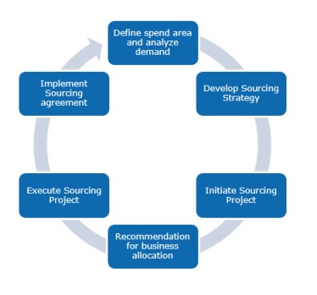
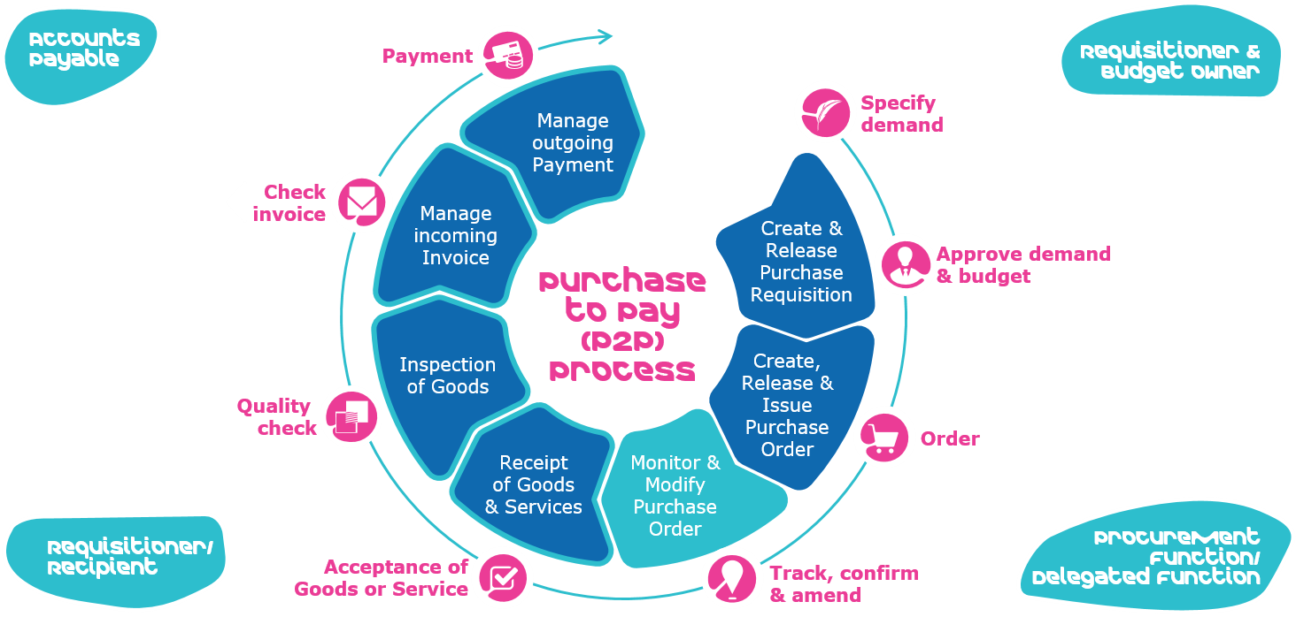
What is Source to Pay (S2P) ?
Commodity/Category
- What: Goods, services, etc.
Sourcing = Procurement/Purchasing
- Who: To buy from/agreement
Procure = Order Management
- How: To buy/order (PO, Non-PO, Pcard)
Pay
- How: To Receive/Approve Invoice/Pay
Source to Contract Process (S2C)
Procure to Pay Process (P2P)
PLUS

Slide 5
Common S2P problems
(Sourcing) Purchasing | (Procure) Order Management | (Pay) Accounts Payable
Reduce Costs / Achieve Savings | User Experience/ Adoption | Late Payments (cycle time)
No Strategy / Vision | Req → PO Cycle time | Invoice Quality / Routing
Supplier Relationships / Capacity / Ownership | Order Mistakes | Paper
Supplier Risk Management | Non PO Purchases | Troubleshooting / Chasing
Contract Terms/ Policy Application | Policy Application / Standardization | Policy Application / Standardization
Leverage Technology | Lack of Automation / Home Grown vs. Cloud | E-Invoice/Payments adoption
Data Accuracy / Analytics / Spend Visibility | Data Accuracy / Analytics | Data Accuracy / Analytics
NO SINGLE ACCOUNTABLE S2P OWNER

Slide 6
What is E-Procurement?
E-Procurement is the acronym of 'Electronic Procurement’
the process of the sourcing, purchase and sale of goods or services through electronic methods using the Internet as a primary medium.

Slide 7
Components of e-Procurement
Indent Management
Define the need via a Tendering workflow
RFX Creation
Request for Proposal/Information/Bids/Quotes
Bid Submission
Via email workflow or portal
Bid Opening and Evaluation
Selection criteria to drive “best value”
E-Auction / Reverse Auction
An alternative that carries some risk
Vendor(s) Selection and Finalization
Could include another round and/or negotiation
Contract Creation & Management
Create vendor in ERP, create contract, create catalogs, etc
Vendor Ongoing Performance Evaluation
Vendor relationship

Slide 8
Benefits of e-Procurement
Reduce cycle time of the whole process
Simplifies / tracks the whole process
Reduce resources / increase capacity
More Cost effective
Easy to maintain / no huge infrastructure needed
Easier management of potential suppliers
Fast and easy way to register and maintain suppliers details.
The confidentiality of the information is assured

Slide 9
2019 Procurement Trends
Digital Strategy in place / Cloud based consistency
- Manual → Digital ; Move to Cloud, Big Data Analytics, etc.
Building Talent Pool to drive Digital Technology
- Talent Shortage, aging workforce, develop skills
Supplier Relationships beyond the Price
- “Best Value” vs. lowest price
Supply Chain Risk Management
- Brexit, Trade Wars/Tariffs, Climate Change, Fraud, Social Sustainability, 2019 Recession
More Increased Focus on Indirect Spending
- 20% spend/80% of suppliers, reduce maverick spend, tail/low dollar spend
Government Adoption / Mandates
- Spend Government funds more wisely, mandate for tax collection purposes (LatAm)
AI / RPA / Voice Driven Automation
- Artificial Intelligence, Robotic Process Automation, Virtual Assistants, Chat Boxes
More Effective Agile Workforce
- Transactional work automation = strategic utilization of talent / developed skill sets
Cybersecurity
- Information loss, Personal Identifiable Information
Blockchain
- centralized, shared, secure data storage vs. siloed databases

Slide 10
What is E-Payables?
E-Payables is the acronym of 'Electronic Accounts Payables/Payments”
Accounts Payable automation solutions used to automate and eliminate the paper and manual elements of processing and paying an organization's invoices.
“The future of AP is Now”

Slide 11
Components of e-Payables

Slide 12
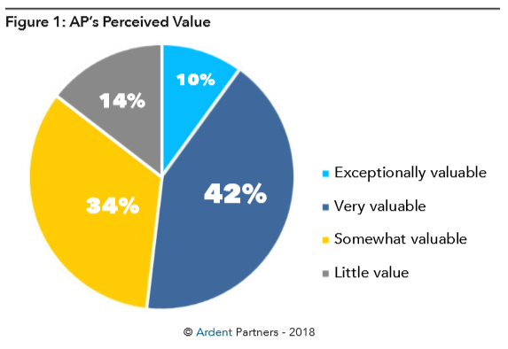
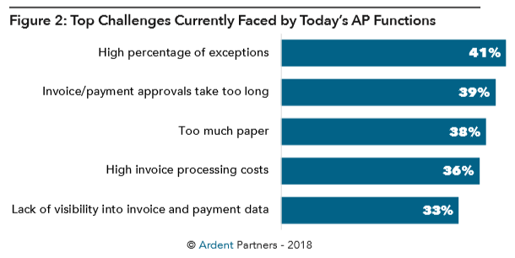
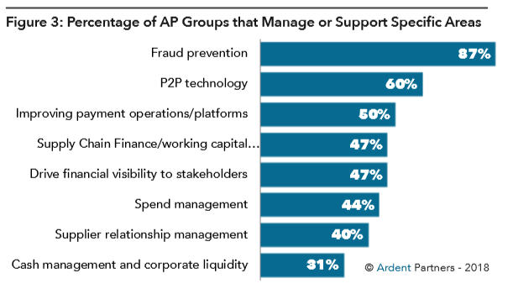
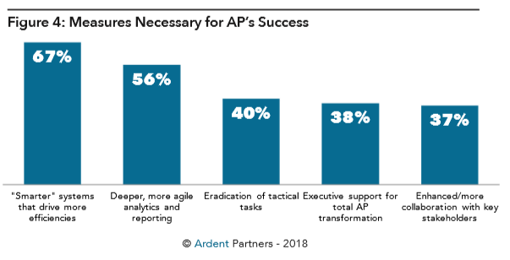
Accounts Payable – Current State

Slide 13
Best in Class E-Payables
Invoice processing cost – 5X lower
Faster cycle times – 2.5X faster
Lower exception rate – 50% lower
Right First Time – 2.4X higher
Less Overdue Invoices - <4%
Improved Cash Flow via Supply Chain Financing
Mitigate Risks (Check vs. ACH)
Payment Administration / Streamlining
Going Green / Less lost invoices & checks
Supplier Portal Self Service
AP Folks freed up for more strategic work
AP Data Analytics to drive daily priorities

Slide 14
2019 E-Payables Trends
AP back office transactional → strategic business
Implement AP Automation Technologies
E-Invoices, E-payments, Workflow, Cloud Solutions
Invoice policy Exceptions/Compliance still a hurdle
Mobility Solutions for approvals / receiving
Increased Collaboration & Convergence with Procurement & Treasury/Banking
Reduce paper invoices / checks
Supply Chain Financing / Dynamic Discounting
Supplier Collaboration via Value Stream Mapping

Slide 15
Questions / Comments?

Slide 16
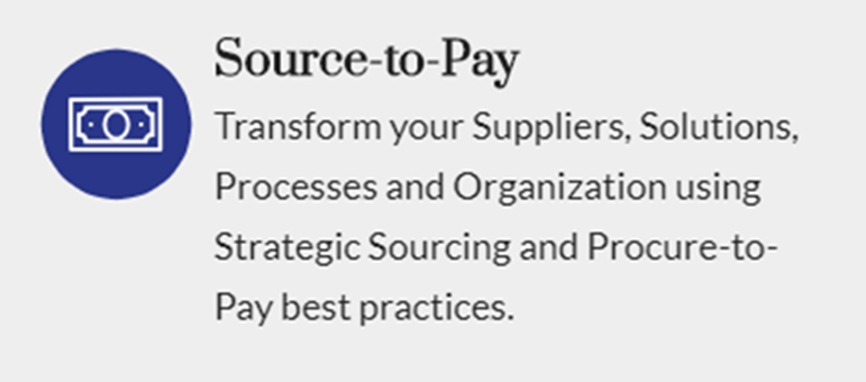
SynFiny Source to Pay
If you don’t have it, we can help you get it.
cloud solutions, strategic buyers
If it is broken, we will help you fix it.
Month end close, Ariba implementation, reporting, vendor/customer master, data visibility
If it works, we will make it better
process improvement, data analytics

